Slide 1

GROUP 10 | DATA7001 | Trial Presentation | May, 2023
INVESTIGATING FACTORS AFFECTING ROAD SAFETY AND SPER DEBT COLLECTION IN QUEENSLAND IN 2021
Presented By:
Presented To:
Nihlahtuzzahra | Jenlarp Wattanakul |Jin Chai
Yifan Zhang | Mansi Mohan Darekar | Yusi Cheng
Joel Mackenzie and Xin Guo

Slide 2


Our Background
Queensland, like any other state in Australia, is facing road safety challenges that affect the well-being and economic growth of the state. The high number of road accidents and the inability to recover SPER debts affect not only the state's revenue but also the safety of its citizens
Our Goals and Motivation
identify the factors that contribute to road accidents and SPER debt accumulation
help develop effective interventions, targeted enforcement strategies, and evidence-based campaigns to promote road safety and reduce SPER debt accumulation.
03

Slide 3

Step to achieve our goals
We implement data science process through this project
4. Making the data confess
2. Getting The Data
Visual Exploratory Data Analysis
Statistical Exploratory Analysis
Data Sources
1. Problem Solving with Data
3. Is the data fit for use?
5. Data Story Telling
Checking Completeness
Checking Accuracy and Consistency
Data Transformation and Integration
Insight
Conclusion and Suggestion
Introduction
Research Question
Key Stakeholders
04

Slide 4



1. Problem Solving with Data
Introduction
Road accidents and unpaid traffic fines/SPER debts are major issues in Queensland that require attention. The high number of incidents in the state emphasizes the need to investigate the contributing factors to road accidents and SPER debt accumulation. Effective interventions that can improve road safety and SPER debt collection require an understanding of these factors. Policymakers, traffic police, road safety advocates, insurance companies, and the general public can benefit from evidence-based strategies that address these issues. Therefore, analyzing relevant datasets and applying data science methods can provide insights that inform decision-making and improve road safety and SPER debt collection in Queensland.
Research Question
What are the main causes of car accidents in Queensland in 2021?
Does the installation of speed cameras necessarily lead to a decrease in the number of crashes?
What are the most significant factors contributing to the State Penalties Enforcement Registry (SPER) debt by SA4 regions in Queensland for 2021?
Key Stakeholders
Government, Traffic Police, Drivers, Insurance Companies and General Public
05

Slide 5
STEP 2.
GETTING THE DATA

Slide 6
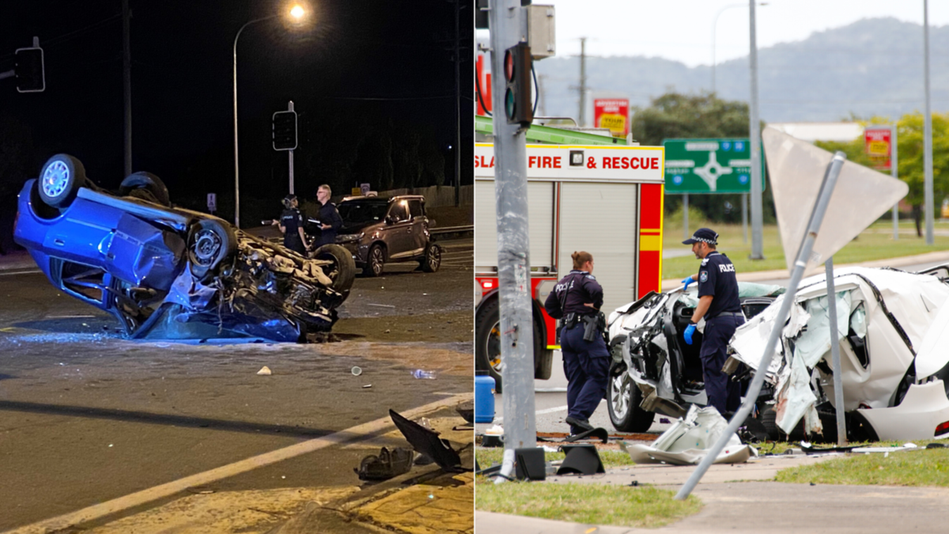
2. Getting The Data
The datasets were obtained from the Open Data Portal Queensland Government and contain information on road accidents, speed camera locations, factors contributing to road accidents, and outstanding SPER debts.
Crash Severity
Fatal Hospitalisation Medical Treatment Minor Injury
Crash Locations
12.467 Crash Points (with latitude and longitude)
Crash Streets
4245 Street Points
Crash Lighting Condition
Darkness - Lighted Darkness - Not lighted Dawn/Dusk Daylight
Local Suburb
1805 Suburb
Local Government Area
70 Areas
Crash Traffic Control
Flashing amber lights Give way sign No traffic control Operating traffic lights Pedestrian crossing sign Pedestrian operated lights Police Railway - lights and boom gate Railway - lights only Railway crossing sign Road/Rail worker Stop sign Supervised school crossing
Local Police Region
7 Police Regions
Crash Road Surface Condition
Sealed - Dry Sealed - Wet Unsealed - Dry Unsealed - Wet
Crash Atmospheric Condition
Clear Fog Raining Smoke/Dust
Local ABS Statistical Area 4
19 Areas
Crash Speed Limit
0 - 50 km/h 100 - 110 km/h 60 km/h 70 km/h 80 - 90 km/h
Data Size: the crash data from Queensland roads in Queensland for all reported Road Traffic Crashes that occurred from 1 January to 31 December 2021
Data Type: All the attribute are Nominal Data
06

Slide 7

2. Getting The Data
The datasets were obtained from the Open Data Portal Queensland Government and contain information on road accidents, speed camera locations, factors contributing to road accidents, and outstanding SPER debts.
Crash Severity
Fatal Hospitalisation Medical Treatment Minor Injury
Local Police Region
7 Police Regions
Involving Drink Driving
Yes/No
Count of (Numeric)
Count_Crashes Count_Fatality Count_Hospitalised Count_Medically_Treated Count_Minor_Injury Count_All_Casualties
Involving Driving Speed
Yes/No
Involving Fatigued Driver
Yes/No
Involving Defective Vehicle
Yes/No
contains information on alcohol, speed, fatigue, and defective vehicle involvement factor in crashes within Queensland for all reported Road Traffic Crashes from 1 January to 31 December 2021
Data Type: All the attribute are Nominal Data, except the count of.
06

Slide 8


2. Getting The Data
The datasets were obtained from the Open Data Portal Queensland Government and contain information on road accidents, speed camera locations, factors contributing to road accidents, and outstanding SPER debts.
Data Type: All the attribute are nominal data
Camera Type
Fix speed cameras, mobile speed cameras, road safety camera trailers, point-to-point speed cameras, combined red light and speed cameras, and parked mobile speed camera sitesolice Regions
Camera Location
Remark of the location
Camera Coordinate
Latitude and Longitude
State Penalties Enforcement Registry (SPER) debt by SA4 regions and the top 10 offence groups in Queensland. Datasets are taken from 2021 SPER data
Month
12 Month of 2021
Top 10 Offence Group by Outstanding Balance
Animal;Bail, Probation and Fail to appear Offences;Driving;Drug Fail to Vote;Fare Evasion Fraud, Deception and Extortion Related Offences;Offender Debt Recovery;Parking;Public Order Offences; Speeding;Stealing; Tolling; Unknown; Vehicle
Local ABS Statistical Area 4
19 Areas
Number of Debts
Numeric Data
Outstanding Balance
Numeric Data
06

Slide 9
STEP 3.
IS THE DATA FIT FOR USE?

Slide 10
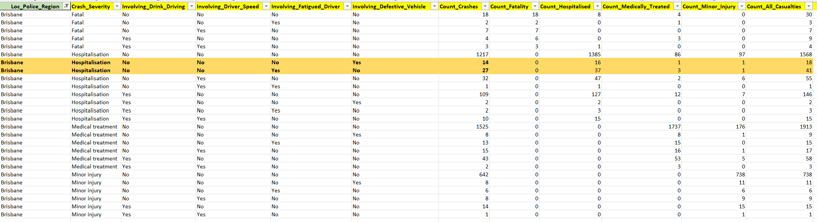
3. Is The Data Fit for Use?
The third step of the data science process is data preparation, which involves assessing and ensuring the fitness of the data for use.
3.1. Check for completeness
We make sure to have all the required data and check for missing values. By using Python code, we confirmed that the data is complete. (See appendix 1.1)
3.2. Check for outliers
We Look for any extreme values in the data that may be erroneous or may skew the analysis. We use statistical methods and also use a boxplot to visualize the distribution of the data. By using Python code, We have identified outliers in our dataset, specifically in the Factor of Crash dataset for the columns Count_Crashes, Count_Fatality, Count_Hospitalised, Count_Medically_Treated, Count_Minor_Injury, and Count_All_Casualties. These outliers are caused by the fact that the values in these columns depend on other columns in the dataset. Despite the presence of outliers, we have determined that they are acceptable and justifiable in the context of our research. Therefore, we have decided to keep them in our dataset. (See appendix 1.2)
To read the Count column data, we read it horizontally from left to right, rather than vertically. For example, we can see that there were 14 crashes in Brisbane with a Hospitalized crash severity that were caused by a Defective Vehicle, while there were 27 crashes that were caused by an Involving Fatigued Driver
06

Slide 11
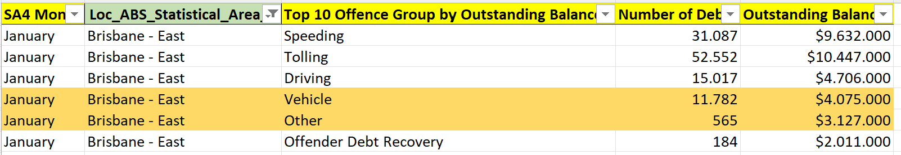
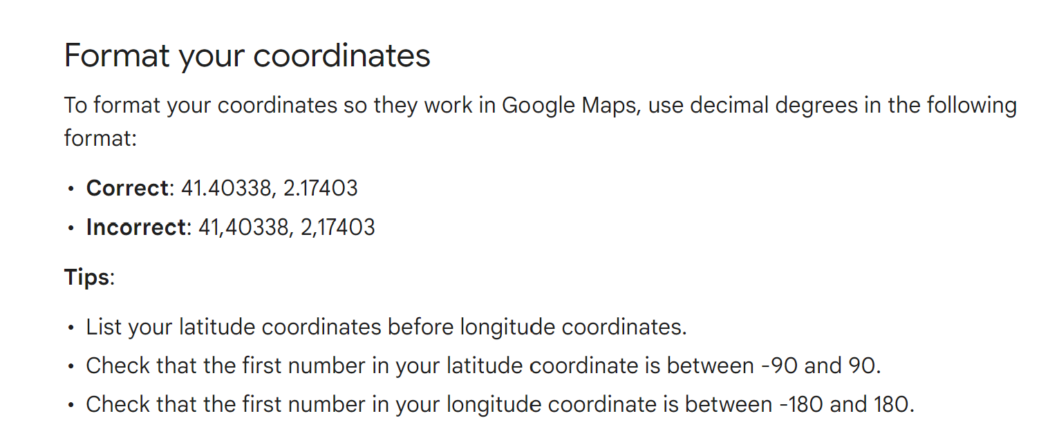
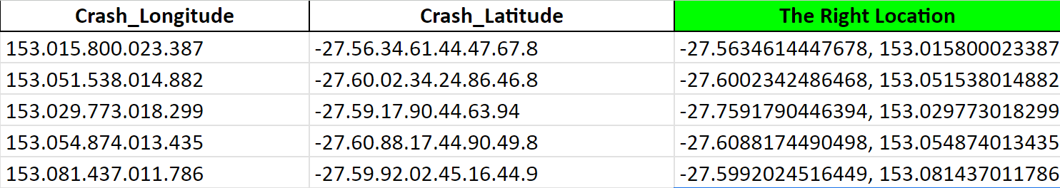
3. Is The Data Fit for Use?
The third step of the data science process is data preparation, which involves assessing and ensuring the fitness of the data for use.
3.2. Check for outliers
We have identified outliers in SPER dataset, for the columns number of Debts and Outstanding Balance. These outliers are caused by the fact that the values in these columns depend on other columns in the dataset. Despite the presence of outliers, we have determined that they are acceptable and justifiable in the context of our research. Therefore, we have decided to keep them in our dataset. (See appendix 1.2)
To read the Count column data, we read it horizontally from left to right, rather than vertically. For example, we can see that in January, in the Brisbane East area, there were 11,782 debtors who were categorized as having committed a vehicle offence, while there were only 565 debtors categorized as having committed other types of offences in that time and area.
3.3. Check for Accuracy
3.1.1 Accuracy of the crash location
The Crash Locations of Crash Data Sets show not standard format. If we check it to google maps, the location not found. So, we re-format it using Decimal Degrees Format and store it into one column.
BEFORE RE-FORMAT
06

Slide 12
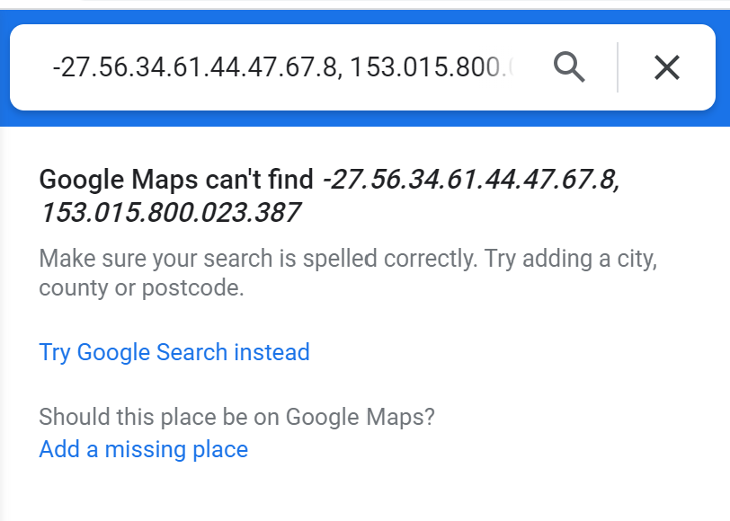
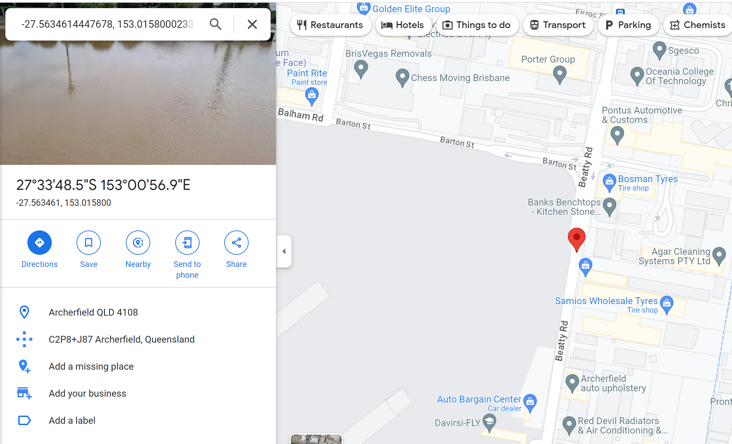
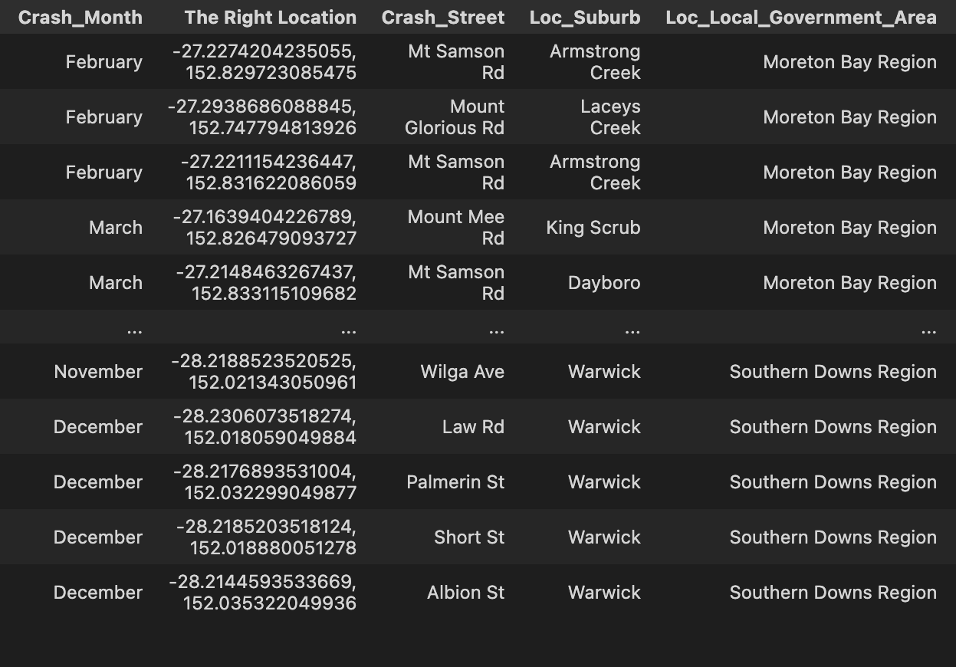
3. Is The Data Fit for Use?
The third step of the data science process is data preparation, which involves assessing and ensuring the fitness of the data for use.
3.3. Check for Accuracy and Consistency
3.3.1 Accuracy of the crash location
The Crash Locations in the Crash Data Set are not in a standard format. When we tried to check them on Google Maps, the locations could not be found. Therefore, we have reformatted the locations using the Decimal Degrees format and stored them in a single column
NOT FOUND
CRASH LOCATION FOUND AFTER RE-FORMAT
CRASH LOCATION AFTER RE-FORMAT
3.3.2 Consistency of the camera location
We discovered that there were no coordinate locations available for the Active Mobile Speed Camera and Road Safety Camera Trailers. However, using a Python query, we were able to determine the coordinates (see Appendices 1.3 and 1.4).
3.3.3 Accuracy of the camera location
We randomly checked the locations of some of the cameras and found that they were not located in Queensland. Some of them were even located in other states or countries. After discovering this, we used a Python query to ensure that all coordinates were located within Queensland (see Appendices 1.5 and 1.6)
06

Slide 13
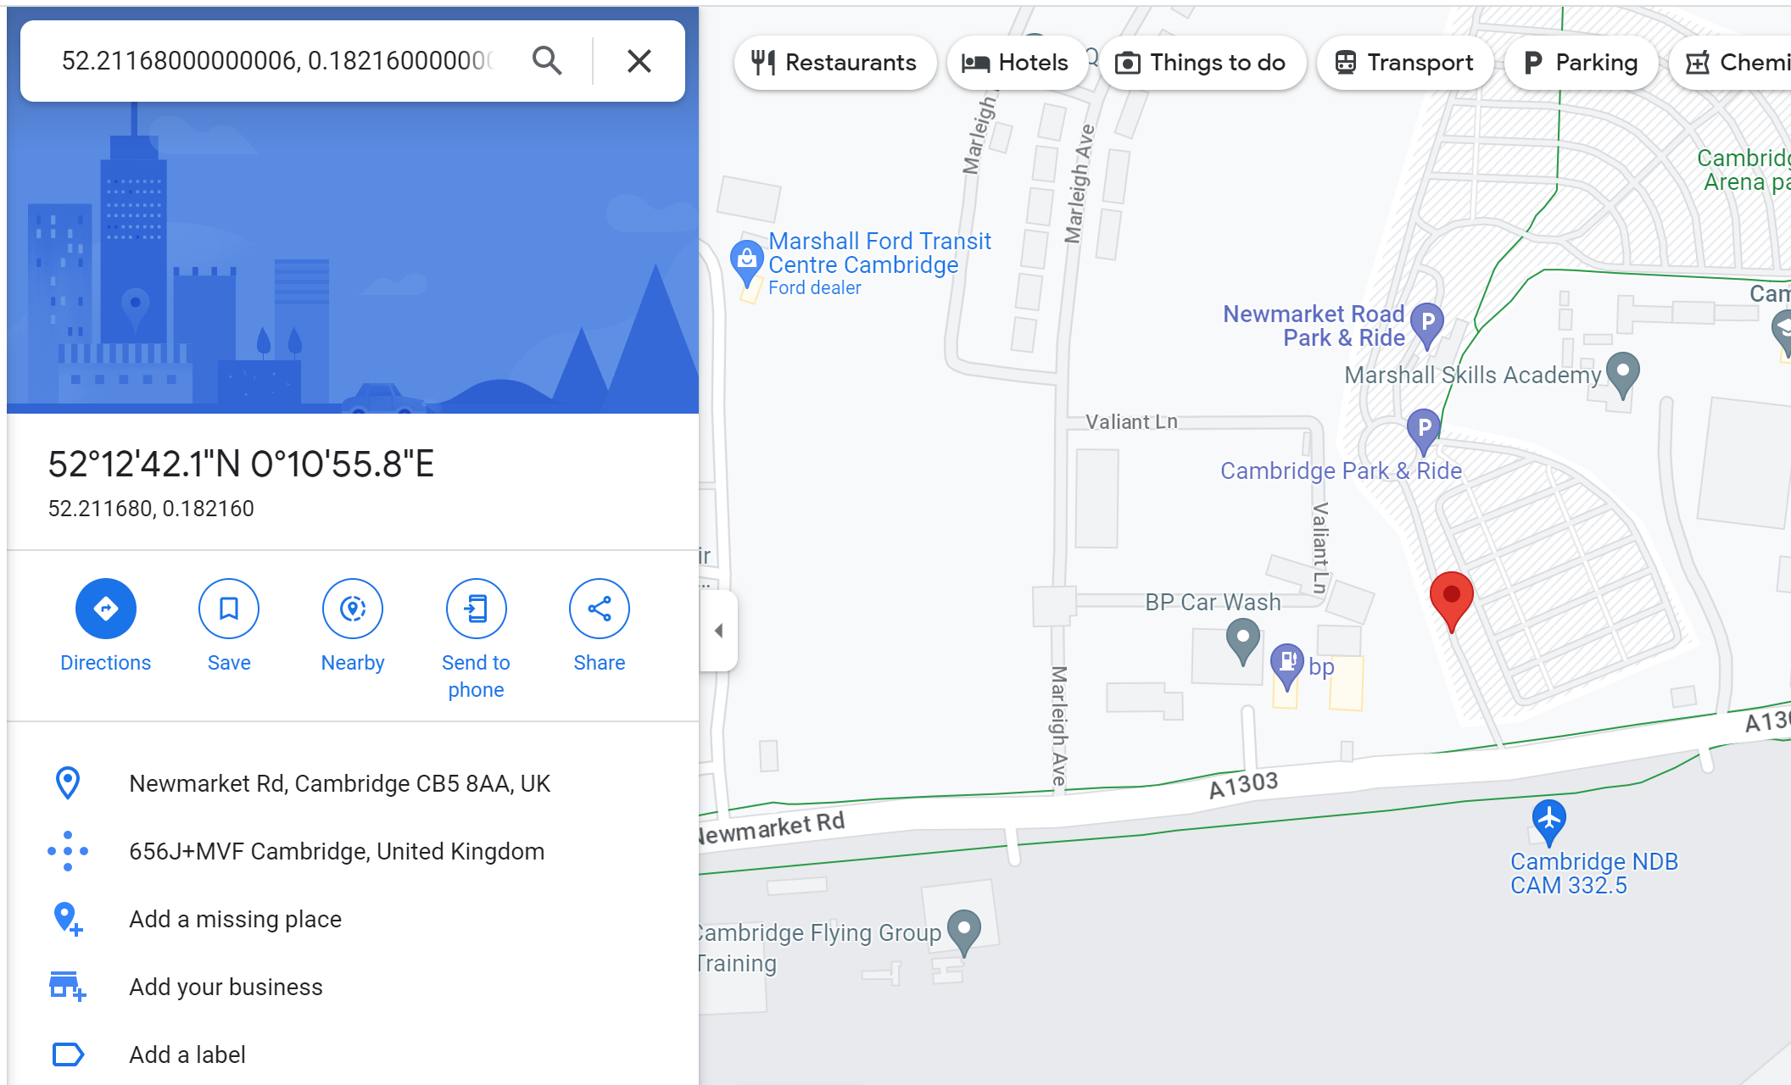
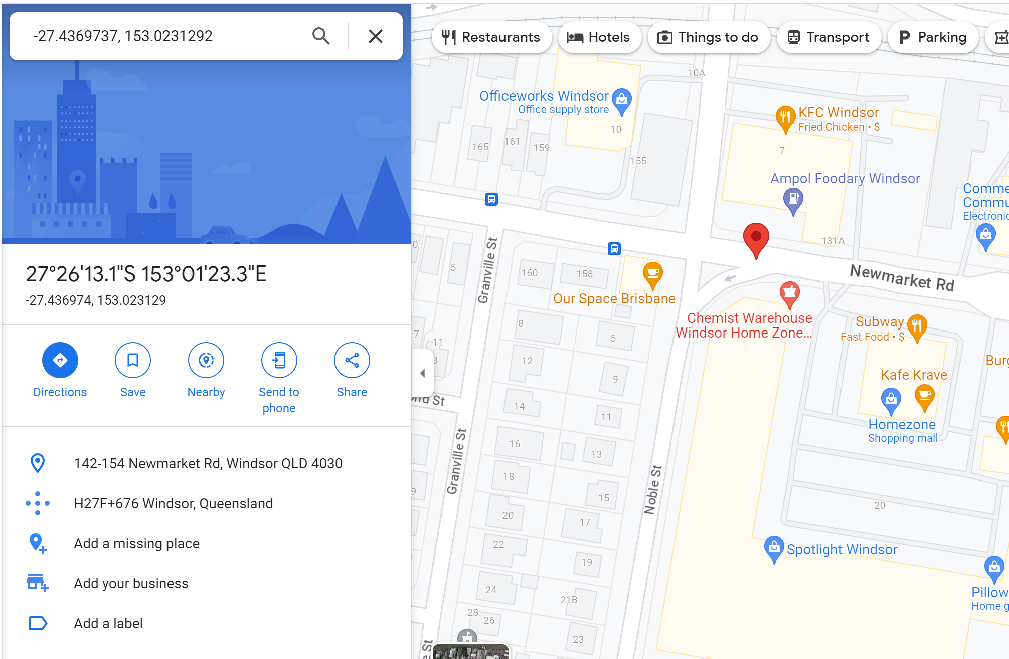
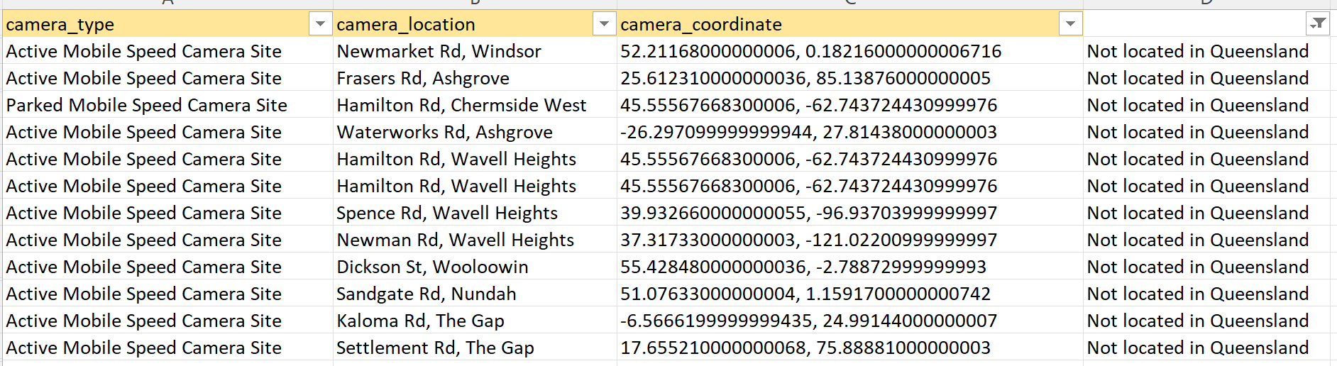
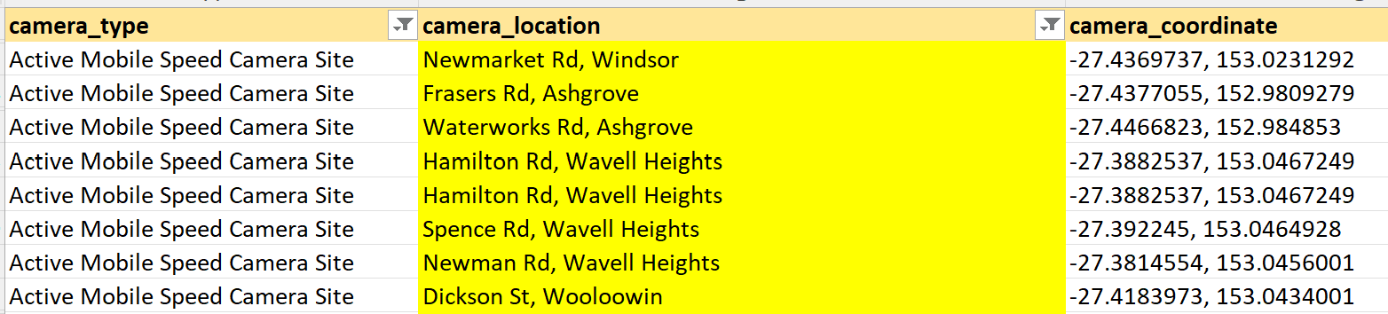
3. Is The Data Fit for Use?
The third step of the data science process is data preparation, which involves assessing and ensuring the fitness of the data for use.
Cont. 3.3.3 Accuracy of the camera location
After identifying the incorrect coordinates, we used Python code to find the correct coordinates for each location, ensuring that they were all located within Queensland
(see Appendix 1.7)
CAMERA LOCATED NOT IN QUEENSLAND
THE CORRECT COORDINATE
CAMERA LOCATED NOT IN QUEENSLAND
THE CORRECT COORDINATE
06

Slide 14
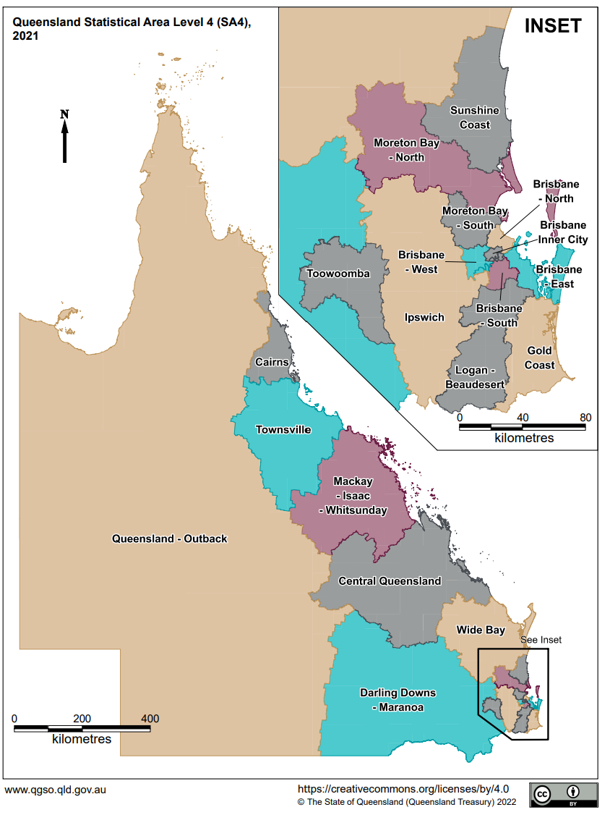
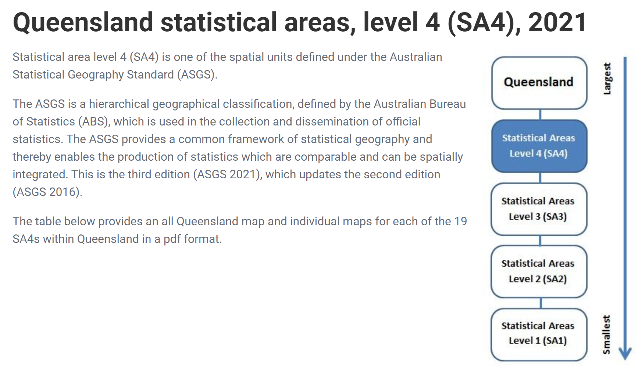
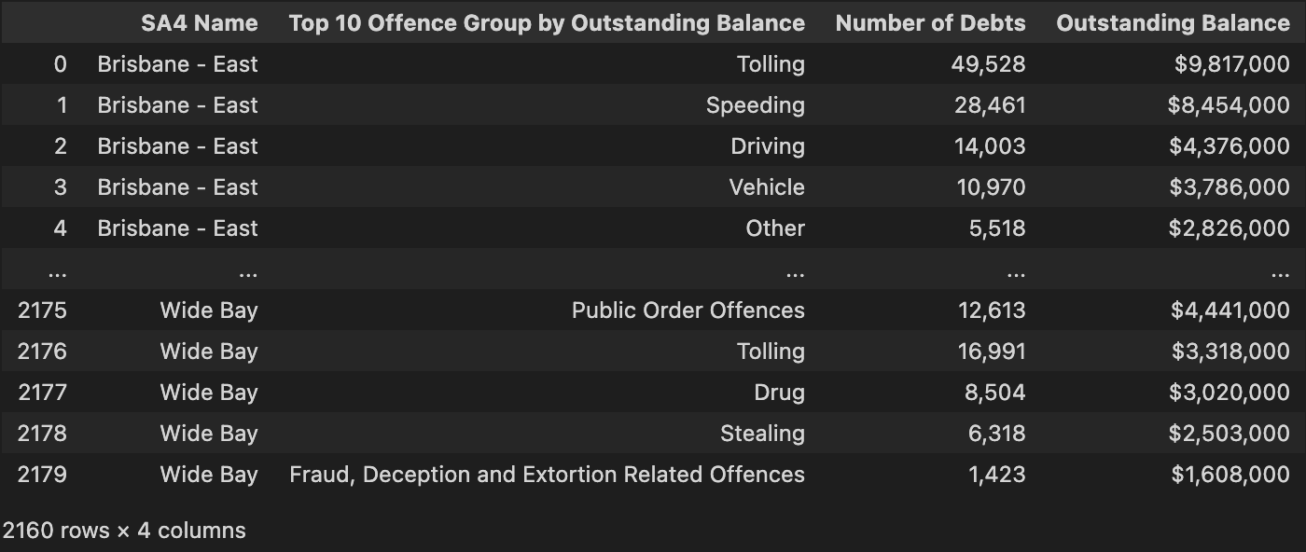
3. Is The Data Fit for Use?
The third step of the data science process is data preparation, which involves assessing and ensuring the fitness of the data for use.
3.3.4 Accuracy and Consistency of The Number of Local ABS (Australian Bureau of Statistics) Statistical Area 4
Based on the Australian Statistical Geography Standard (ASGS), ABS SA4 consists of 19 areas. Because of in the Crash Data Set, we have a column for Local ABS Statistical Area 4, therefore, in the SPER Data Set, we verified that the ABS SA4 column only includes these 19 areas with regard to the Outstanding Balance. We used Python code to perform this verification (see Appendix 1.8)
SA4 NAME CONSISTS OF 19 AREAS
06

Slide 15
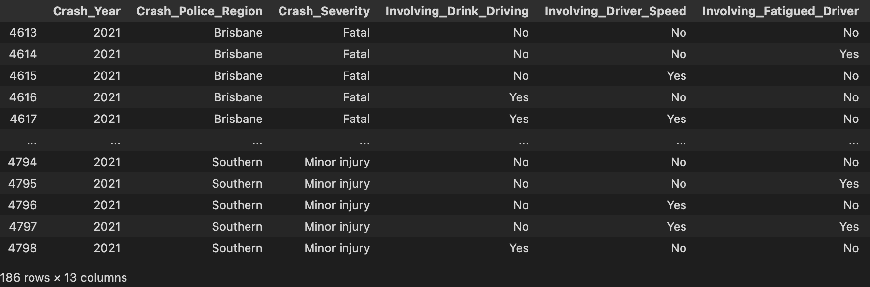
3. Is The Data Fit for Use?
The third step of the data science process is data preparation, which involves assessing and ensuring the fitness of the data for use.
3.3.5 Year Consistency
Since the SPER Data Set only contains data from 2021, we wanted to ensure that the Crash Data Set and the Factor of Crash Data Set also only included data from 2021 for balance and consistency. We used Python code to filter the data sets accordingly (see Appendix 1.9).
FACTOR OF CRASH (2021 ONLY)
06

Slide 16
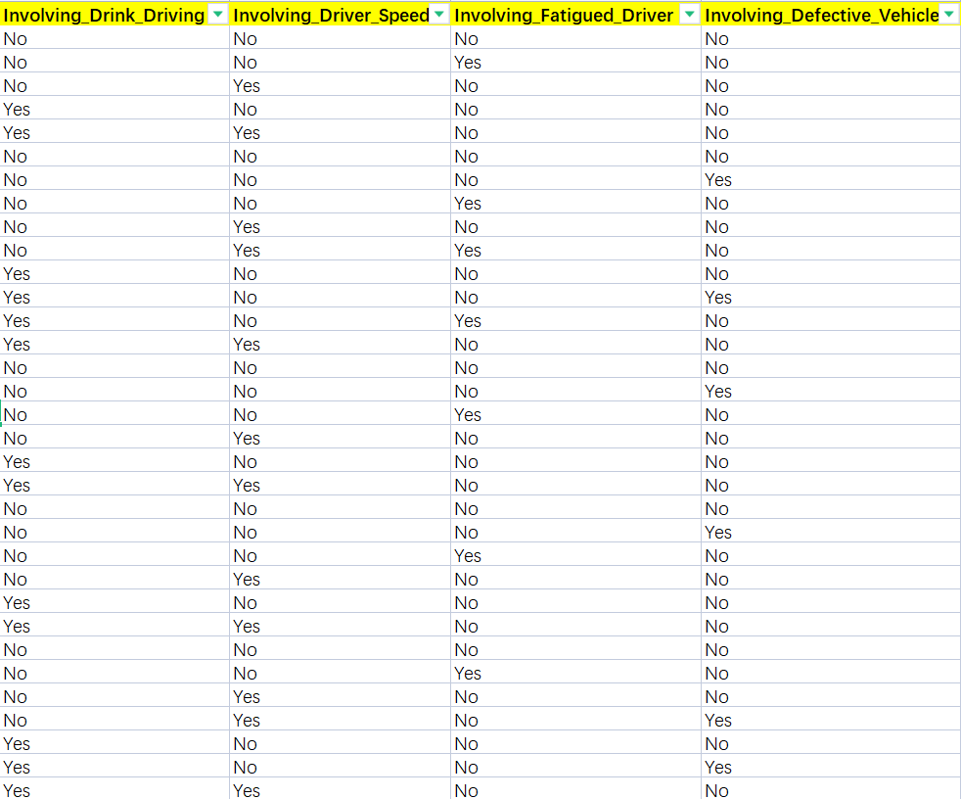
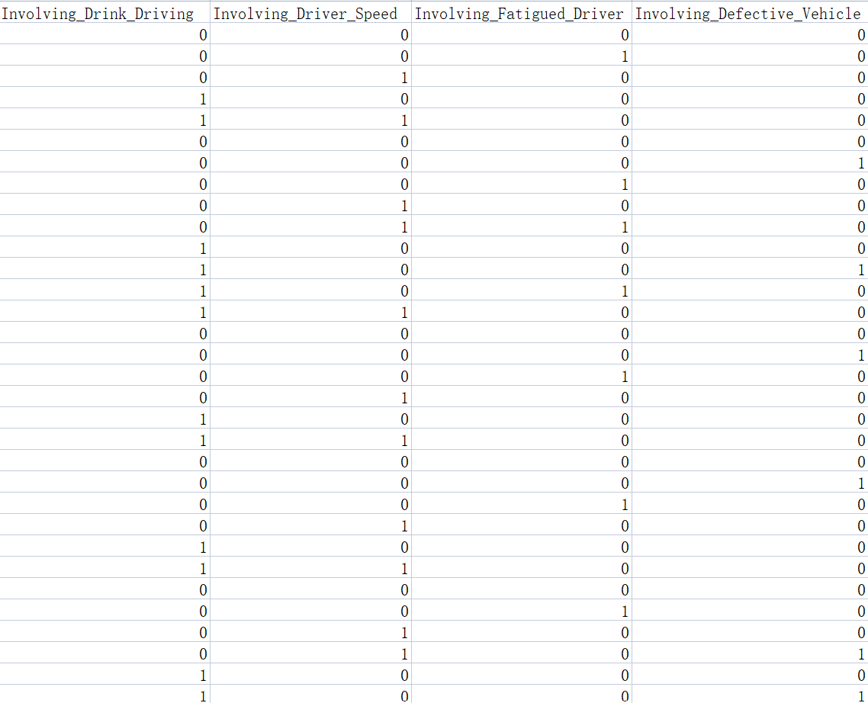
3. Is The Data Fit for Use?
The third step of the data science process is data preparation, which involves assessing and ensuring the fitness of the data for use.
3.4. Data Transformation
3.4.1 Factor of Crash
We converted four columns of Factor of Crash Data from string type to numerical type, replacing the values of 'yes' and 'no' with 1 and 0, respectively. This conversion will make it more convenient for us to perform data analysis on these columns. (See Appendix 1.11)
Data in string
Data in numeric
06

Slide 17
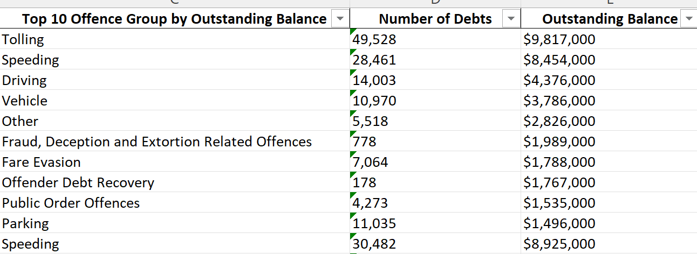
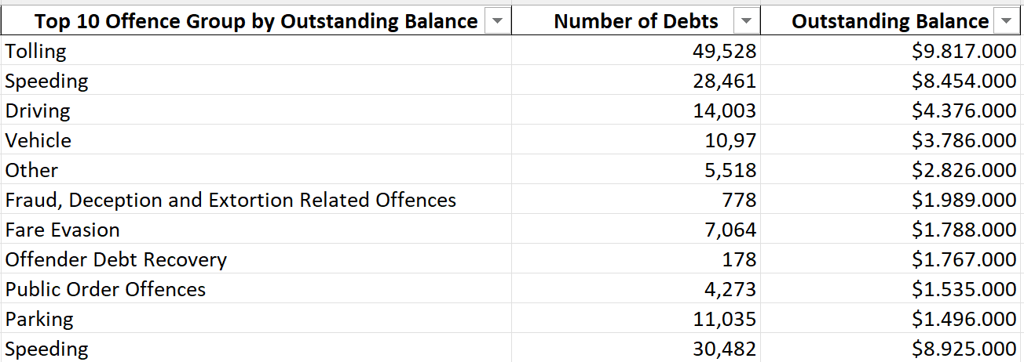
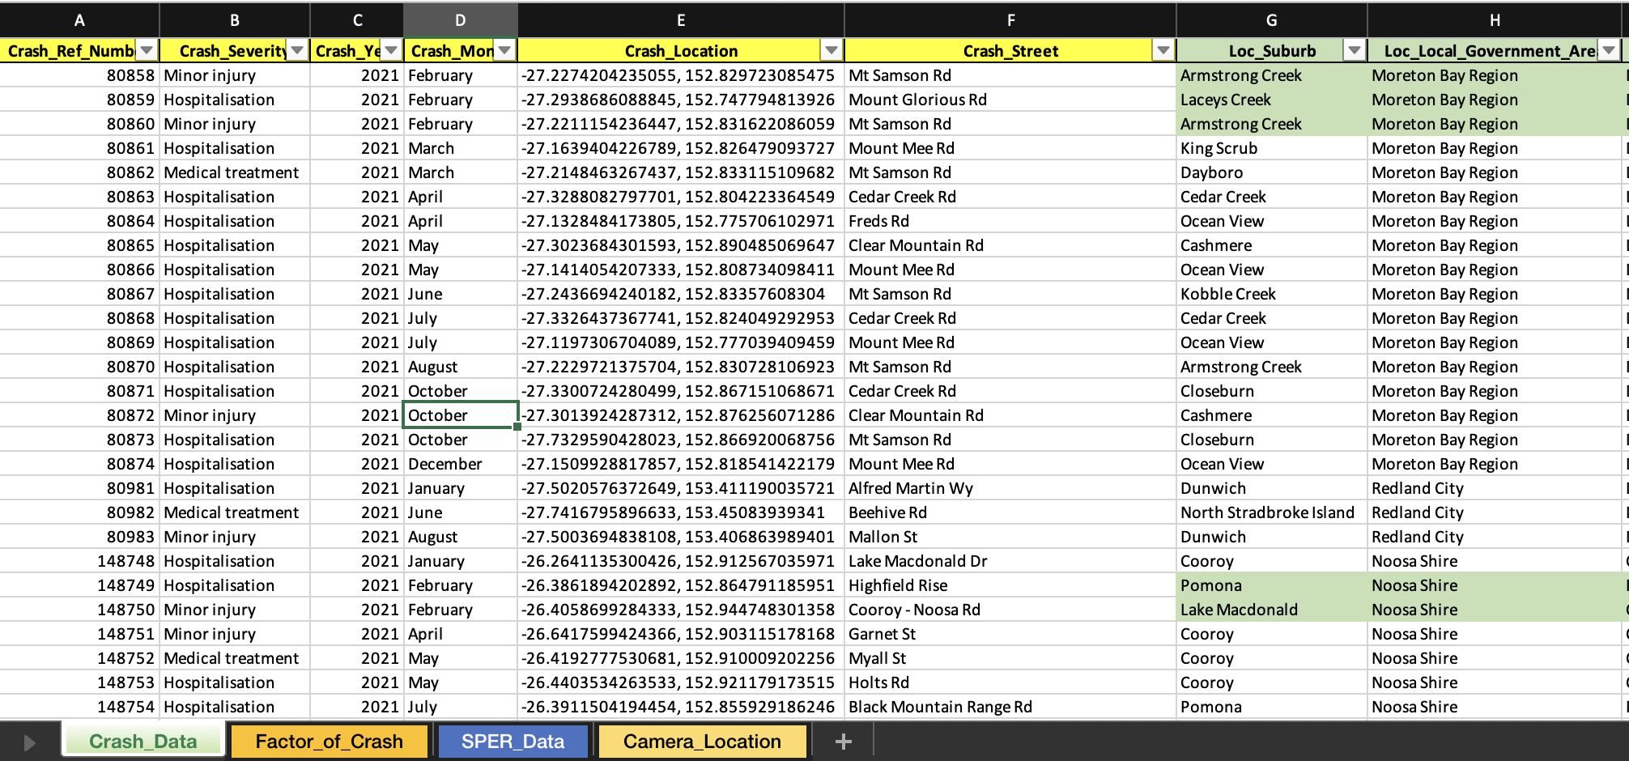
3. Is The Data Fit for Use?
The third step of the data science process is data preparation, which involves assessing and ensuring the fitness of the data for use.
3.4. Data Transformation
3.4.2 Outsanding Balance of SPER
We found that the outstanding balance in the SPER dataset was in string format, which prevented us from performing calculations on it. To address this issue, we converted the column to numeric format using Python code (See Appendix 1.12).
BEFORE CONVERTED
AFTER CONVERTED
3.5. Data Integration
To make our data analysis tasks more efficient, effective, and insightful, we used Python code to integrate multiple datasets into one data file (see Appendix 1.10).

Slide 18
STEP 4.
MAKING THE DATA CONFESS

Slide 19
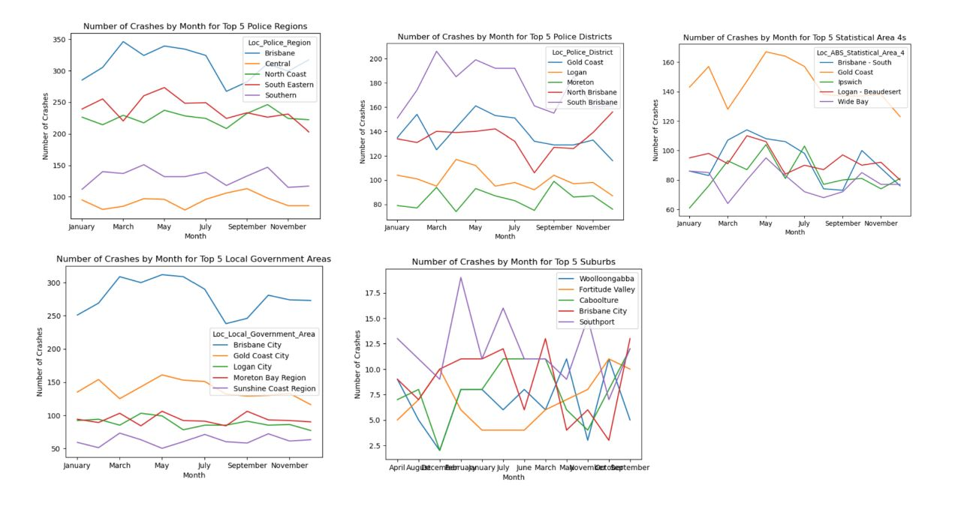
4. Making The Data Confess
The fourth step of the data science process involves making the data confess. During this step, we analyze and visualize the data to uncover hidden insights and patterns. By doing so, we aim to extract meaningful information that can help us answer our research or make predictions.
4.1 Exploratory Data Analysis
4.1.1 Exploration Top 5 Crash Location in The Queensland
We are attempting to identify patterns in the occurrence of crashes throughout the year in various locations, such as police regions, police districts, SA4 regions, local government areas, and suburbs. (Code in Appendix 2.1)
INSIGHT:
The number of crashes that occurred across all areas fluctuated significantly throughout the year 2021. When considering the Local Government Areas, Brisbane City, Gold Coast City, Logan City, Moreton Bay Region, and Sunshine Coast Region were the top five areas with the highest number of crashes throughout the year. Additionally, the Brisbane Police Regions had the highest crash rate in 2021, followed by the North Brisbane Police Districts. In terms of the Local ABS SA4 areas, the Gold Coast had the highest number of crashes throughout the year 2021. In conclusion, further investigation is needed to identify the factors contributing to the high number of crashes in the top five cities during 2021.

Slide 20
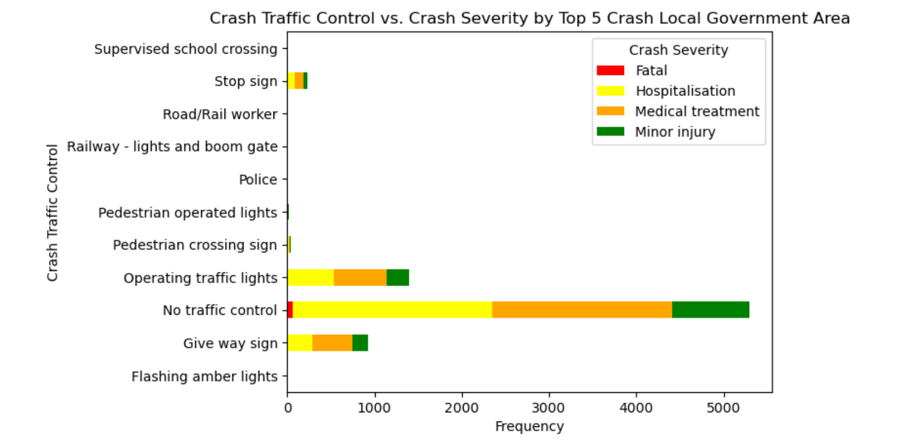
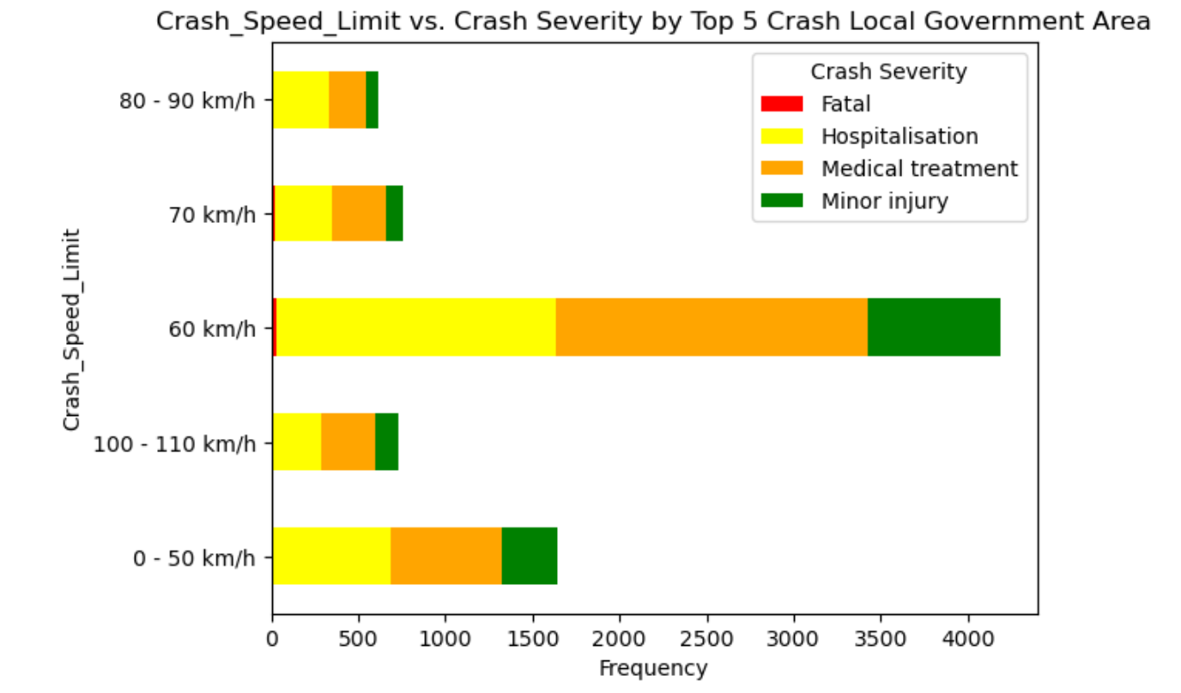
4. Making The Data Confess
The fourth step of the data science process involves making the data confess. During this step, we analyze and visualize the data to uncover hidden insights and patterns. By doing so, we aim to extract meaningful information that can help us answer our research or make predictions.
4.1 Exploratory Data Analysis
4.1.2 factors that contributed to the severity of the crashes in the top 5 Local Government Areas.
Based on the previous findings, we know that the top five areas with the highest number of crashes throughout the year are the Local Government Areas of Brisbane City, Gold Coast City, Logan City, Moreton Bay Region, and Sunshine Coast Region. Therefore, we will investigate further to identify the factors that contributed to the crashes in these areas. (Code in Appendix 2.2)
INSIGHT:
Based on the above diagram, the majority of crash severity incidents were classified as hospitalization and medical treatment. The three primary causes of crashes were the absence of traffic control, which accounted for 5000 cases, followed by operating traffic lights, which were responsible for approximately 1500 cases, and Give Way Signs, which caused 1000 cases. Interestingly, when examining driver speed, the highest number of crashes occurred at 60 km per hour, rather than at speeds of 100-110 km per hour.

Slide 21
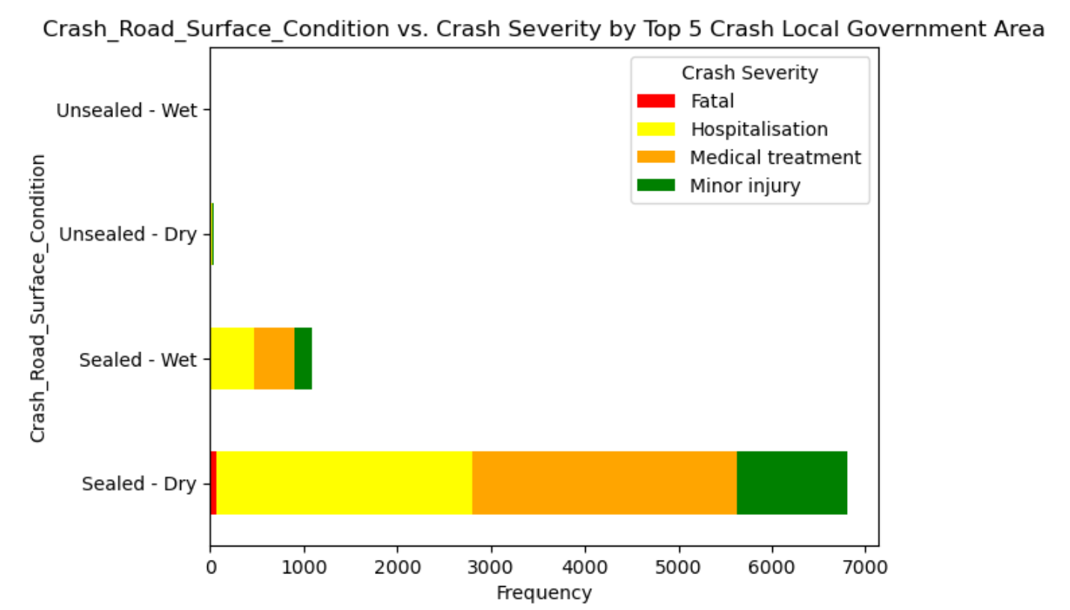
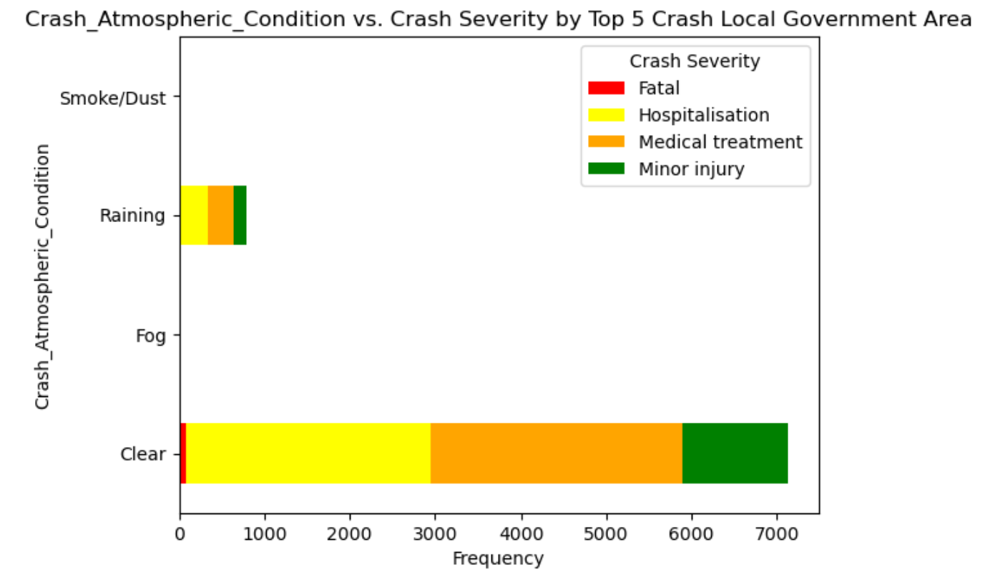
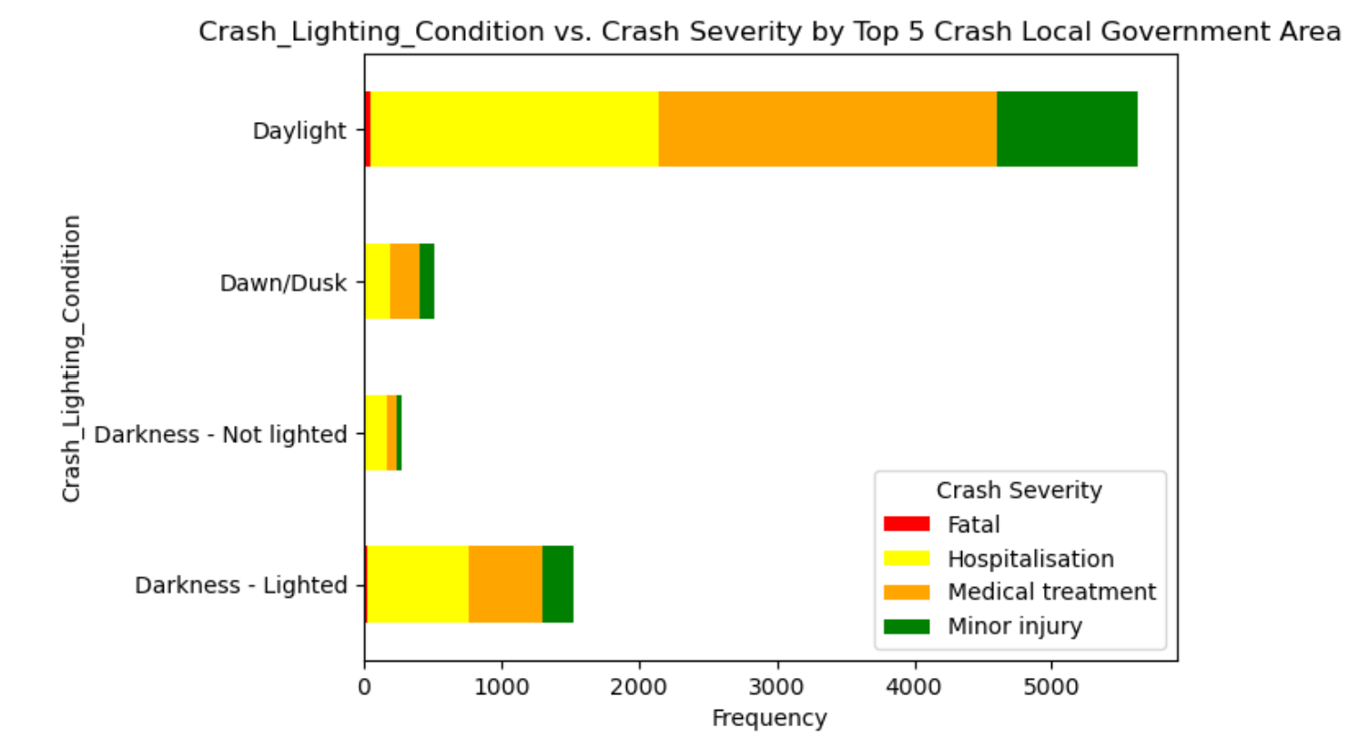
4. Making The Data Confess
The fourth step of the data science process involves making the data confess. During this step, we analyze and visualize the data to uncover hidden insights and patterns. By doing so, we aim to extract meaningful information that can help us answer our research or make predictions.
4.1 Exploratory Data Analysis
4.1.2 factors that contributed to the severity of the crashes in the top 5 Local Government Areas.
Based on the previous findings, we know that the top five areas with the highest number of crashes throughout the year are the Local Government Areas of Brisbane City, Gold Coast City, Logan City, Moreton Bay Region, and Sunshine Coast Region. Therefore, we will investigate further to identify the factors that contributed to the crashes in these areas. (Code in Appendix 2.2)
INSIGHT:
Based on the above graph, the most frequent crash severity levels were hospitalization and medical treatment. The highest number of crashes occurred under the road surface conditions of sealed-dry and sealed-wet, with 6900 and 1000 cases, respectively. Interestingly, these crashes occurred during clear atmospheric conditions and daylight lighting conditions.

Slide 22
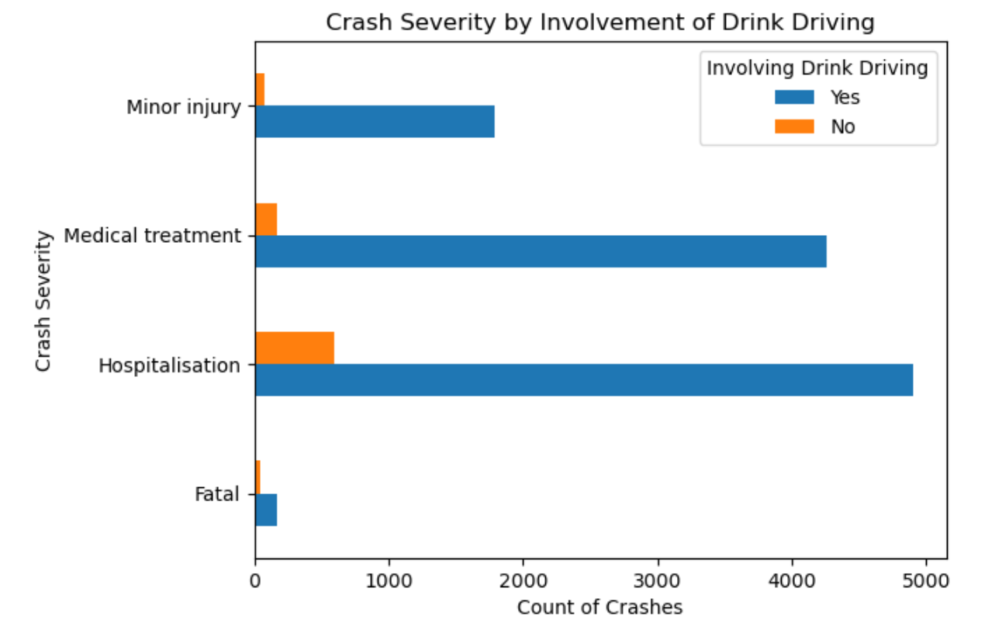
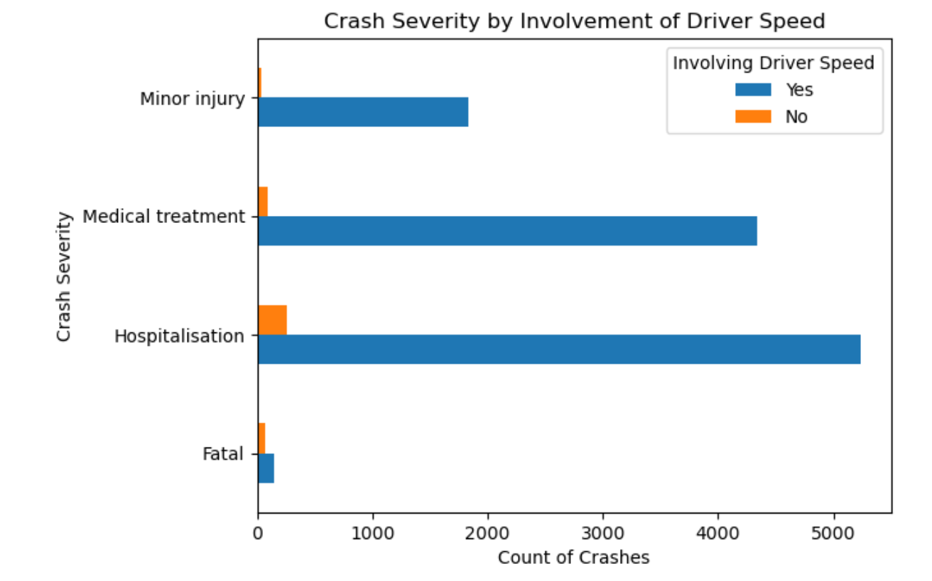
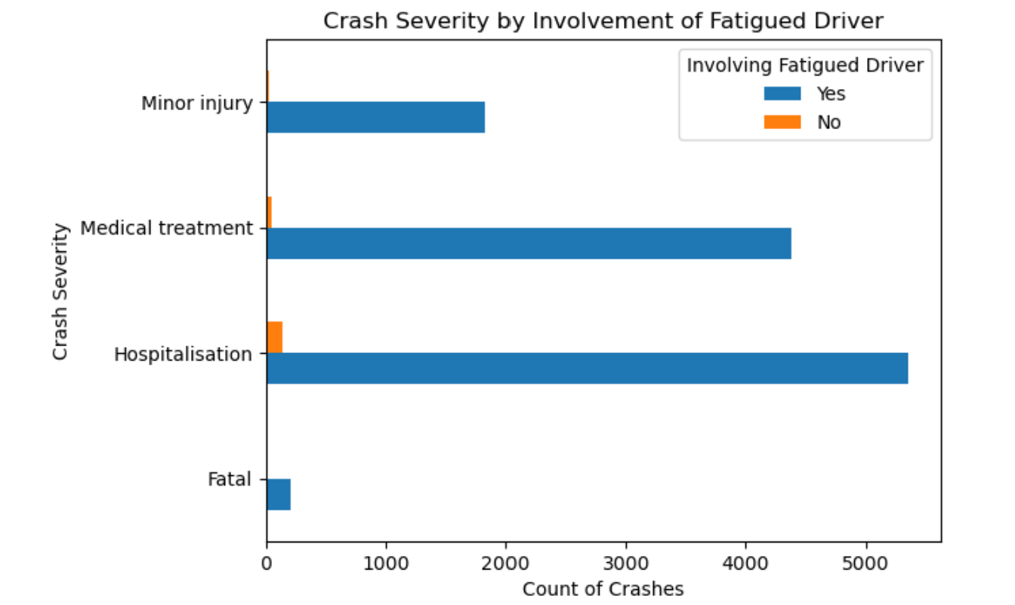
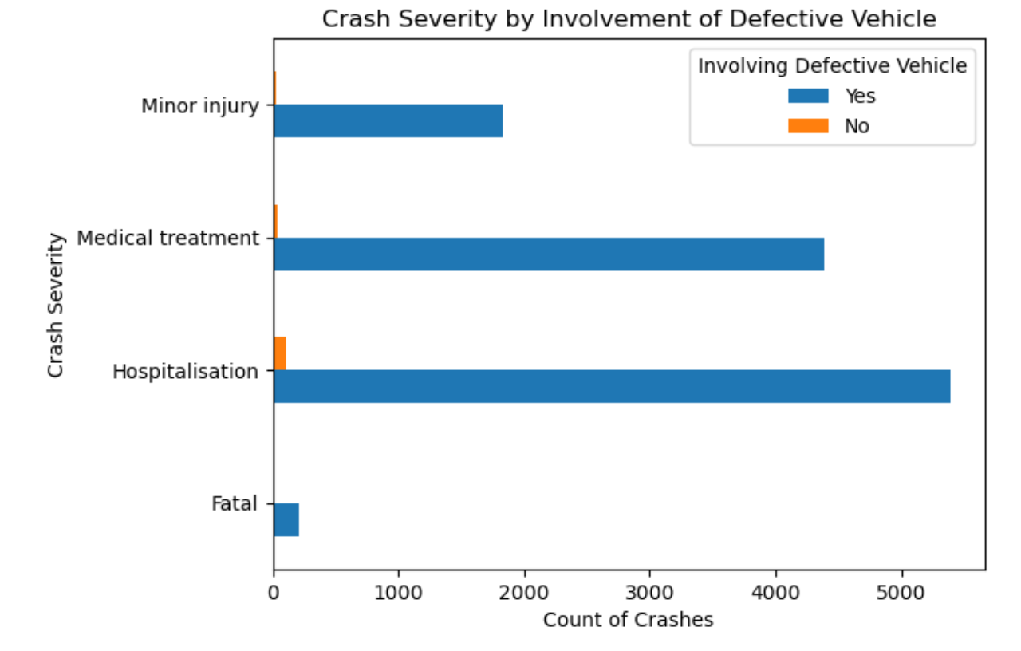
factors that contributed to the severity of the crashes in the top 5 areas.
4. Making The Data Confess
4.1 Exploratory Data Analysis
4.1.3 Involvement factors that contributed to the severity of the crashes in the top 5 Local Police Regions
Based on our previous findings, it was determined that the top five Local Police Regions with the highest number of crashes throughout the year were Brisbane, Central, North Coast, South Eastern, and Southern. To identify the factors that contributed to the severity of crashes in these regions, we will use the involvement factors of the crash, specifically, drink driving, driver speed, fatigued driver, and defective vehicle. Please refer to Appendix 2.2 for the code used in this investigation.
INSIGHT:
All of the graphics demonstrate that hospitalization is the most prevalent crash severity resulting from the involvement of drinking while driving, driver's speed, fatigued driving, and defective vehicle.

Slide 23
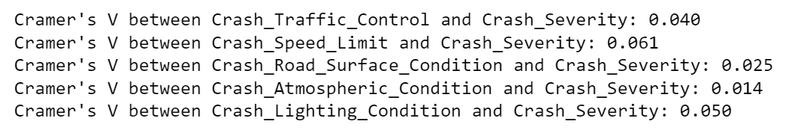
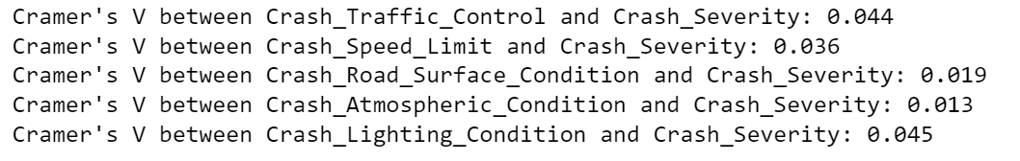
4. Making The Data Confess
The fourth step of the data science process involves making the data confess. During this step, we analyze and visualize the data to uncover hidden insights and patterns. By doing so, we aim to extract meaningful information that can help us answer our research or make predictions.
4.1 Exploratory Data Analysis
4.1.4 Association strength between factors of crash to the crash severity
To determine the influence of each factor on crash severity, we will use Cramer's V, a measure of association strength between nominal variables. Cramer's V is a measure of the strength of association between two nominal variables, and its value ranges from 0 to 1. (Code in Appendix 2.3)
IN ALL AREAS
CRASHES IN THE TOP 5 LOCAL GOVERNMENT AREAS
INSIGHT:
The Cramer's V values between the predictor variables (Crash_Traffic_Control, Crash_Speed_Limit, Crash_Road_Surface_Condition, Crash_Atmospheric_Condition, and Crash_Lighting_Condition) and the response variable (Crash_Severity) indicate the strength of association between them, with values ranging from 0 to 1. A higher value indicates a stronger association between the variables.
In all areas of crashes, the Cramer's V values range from 0.014 to 0.061, indicating a weak to moderate association between the predictor variables and Crash_Severity. However, when we focus on the top 5 areas of crashes (Brisbane City, Gold Coast City, Logan City, Moreton Bay Region, and Sunshine Coast Region), the Cramer's V values range from 0.013 to 0.045, indicating a slightly weaker association between the predictor variables and Crash_Severity compared to all areas of crashes.
Overall, these results suggest that while there is some association between the predictor variables and Crash_Severity, the strength of these associations is not particularly strong in either all areas of crashes or the top 5 areas of crashes.

Slide 24
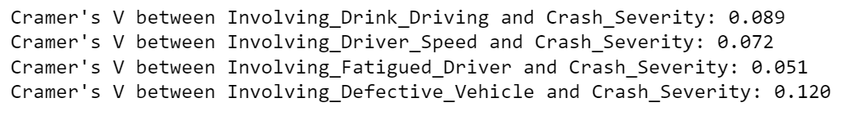
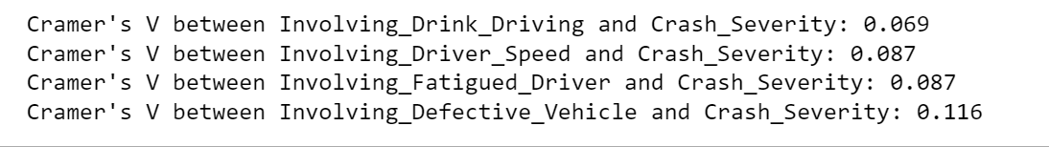
4. Making The Data Confess
The fourth step of the data science process involves making the data confess. During this step, we analyze and visualize the data to uncover hidden insights and patterns. By doing so, we aim to extract meaningful information that can help us answer our research or make predictions.
4.1 Exploratory Data Analysis
4.1.4 Association strength between involvement factors that contributed to the severity of the crashes
To determine the influence of each factor on crash severity, we will use Cramer's V, a measure of association strength between nominal variables. Cramer's V is a measure of the strength of association between two nominal variables, and its value ranges from 0 to 1. (Code in Appendix 2.4)
IN ALL AREAS
CRASHES IN THE TOP 5 LOCAL GOVERNMENT AREAS
INSIGHT:
The output shows the strength of association between each predictor variable (Involving_Drink_Driving, Involving_Driver_Speed, Involving_Fatigued_Driver, Involving_Defective_Vehicle) and the response variable (Crash_Severity) using Cramer's V statistic. In all areas of crash, the highest association is observed between Involving_Defective_Vehicle and Crash_Severity (Cramer's V = 0.12), followed by Involving_Drink_Driving and Crash_Severity (Cramer's V = 0.089). On the other hand, the lowest association is observed between Involving_Fatigued_Driver and Crash_Severity (Cramer's V = 0.051).
When focusing on the top 5 areas in Loc_Police_Region, the results are similar, with Involving_Defective_Vehicle and Crash_Severity showing the strongest association (Cramer's V = 0.116) and Involving_Fatigued_Driver showing the weakest association (Cramer's V = 0.087). However, there is a difference in the association strength between Crash_Severity and Involving_Driver_Speed and Involving_Fatigued_Driver, where their association strength in the top 5 areas is stronger than in all areas of crash.
Overall, the results suggest that Involving_Defective_Vehicle and Involving_Drink_Driving are the two most important predictor variables associated with Crash_Severity in all areas of crash, and this finding is consistent with the top 5 areas in Loc_Police_Region.

Slide 25
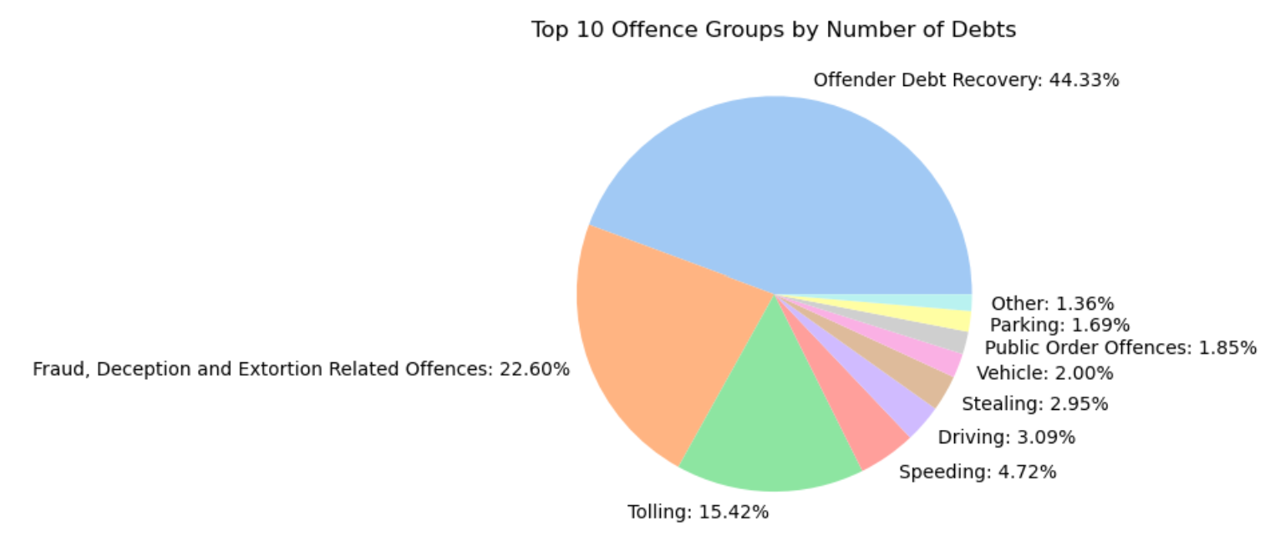
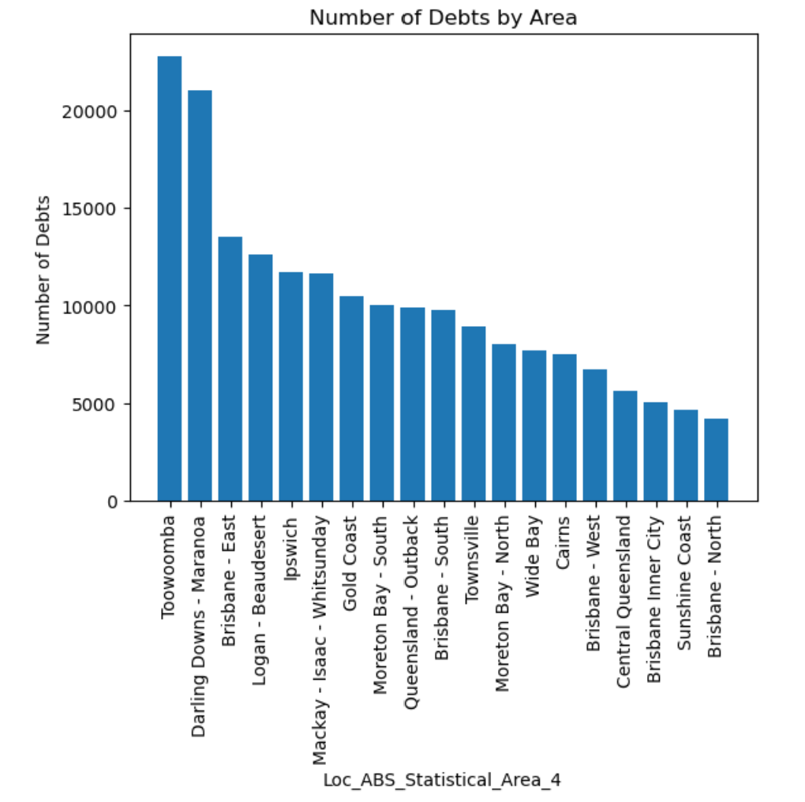
4. Making The Data Confess
The fourth step of the data science process involves making the data confess. During this step, we analyze and visualize the data to uncover hidden insights and patterns. By doing so, we aim to extract meaningful information that can help us answer our research or make predictions.
4.1 Exploratory Data Analysis
4.1.5 Top 10 Offence Contributed to Number of Debtors
Nearly half of the total number of debts is caused by offender debt recovery (44.33%), followed by Fraud Offence at 22.60% and Tolling at 15.42%. The regions with the highest number of debts are Toowoomba, Darling Downs, and Brisbane East.

Slide 26
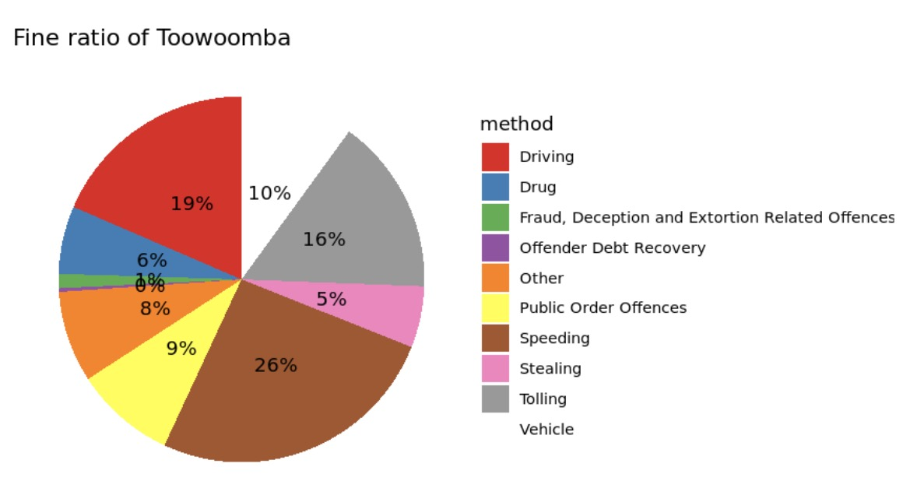
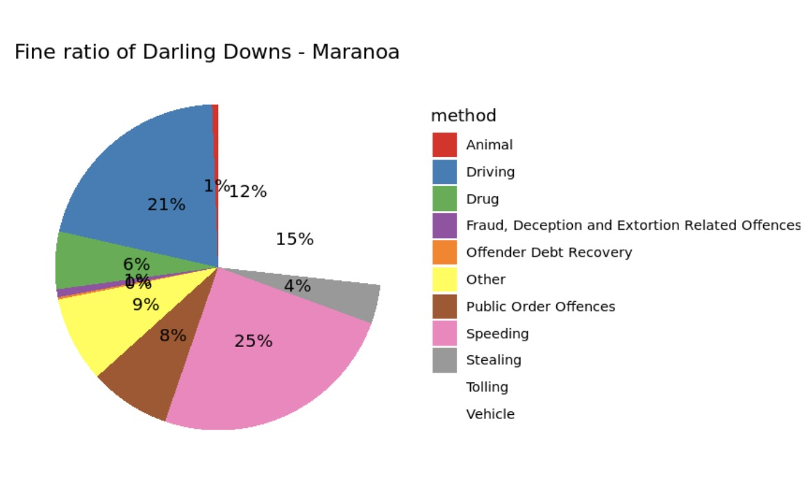
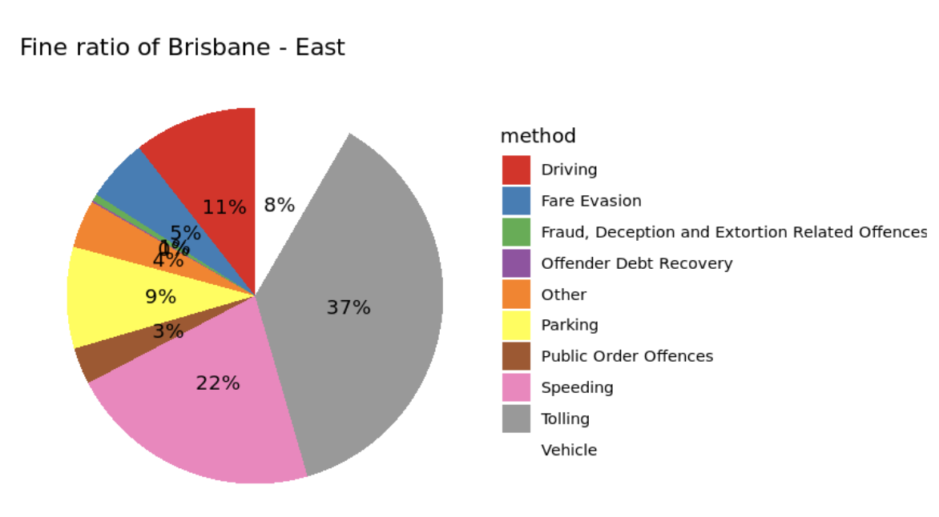
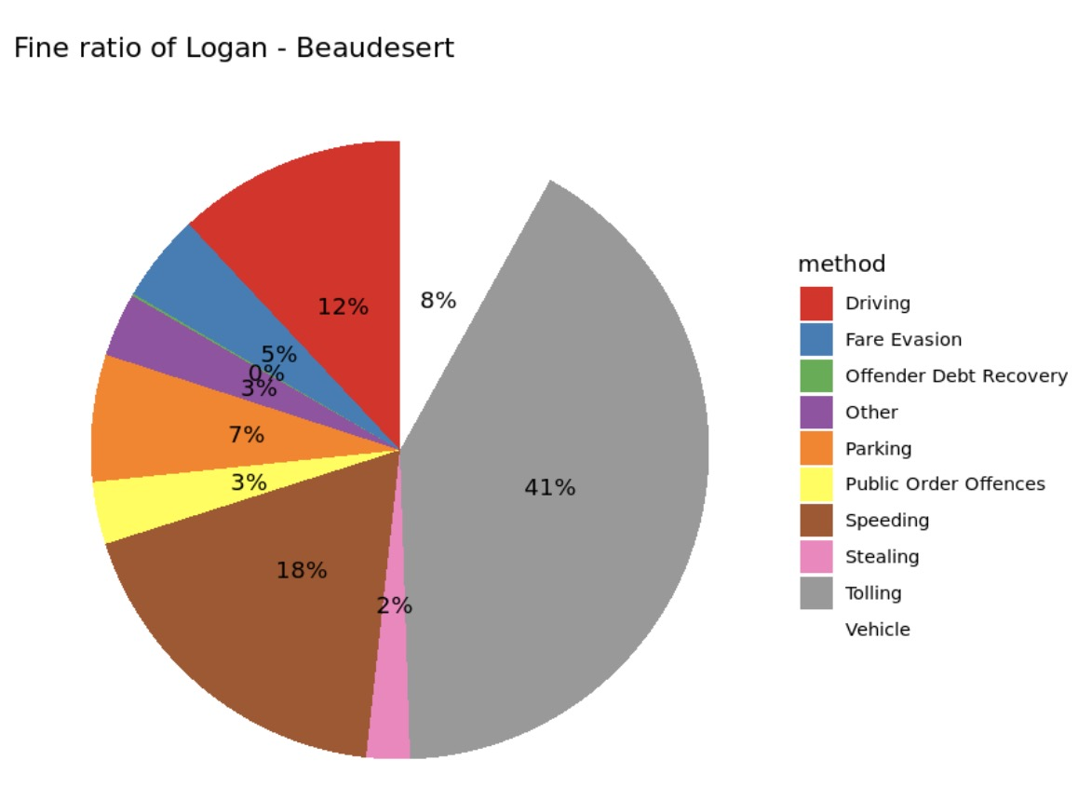
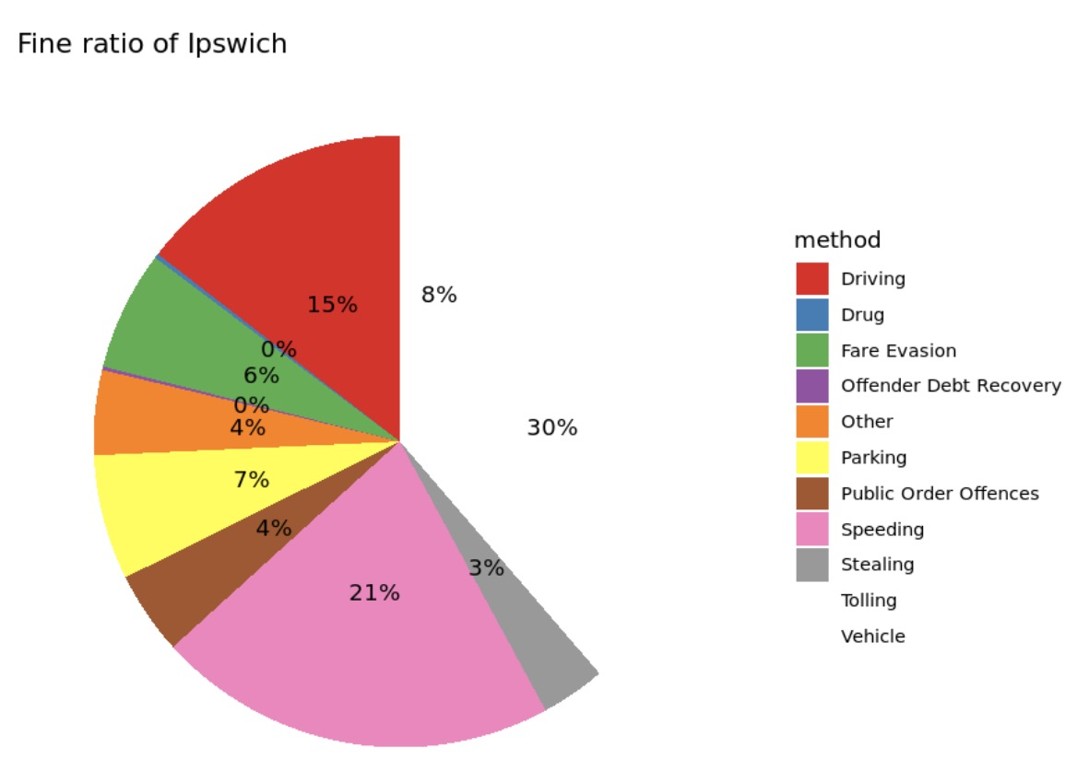
4. Making The Data Confess
The fourth step of the data science process involves making the data confess. During this step, we analyze and visualize the data to uncover hidden insights and patterns. By doing so, we aim to extract meaningful information that can help us answer our research or make predictions.
4.1 Exploratory Data Analysis
4.1.6 Proportion of Offence Contributed to Number of Debtors
Based on the previous graph, it can be observed that the five areas with the highest number of debtors are located in Toowomba, Darlig Downs, Brisbane-East, Logan, and Ipswich. In order to obtain a more detailed insight into the factors that contribute to the high number of debtors, a pie chart can be created to determine the proportion of each offence group that has contributed to the number of debtors.
INSIGHT:
Across all five regions, speeding consistently contributes around 20% to the number of debtors. Also, Tolling is the main contributor to the number of debtors in Logan, accounting for 41%, followed by 37% in Brisbane East and 30% in Ipswich.

Slide 27
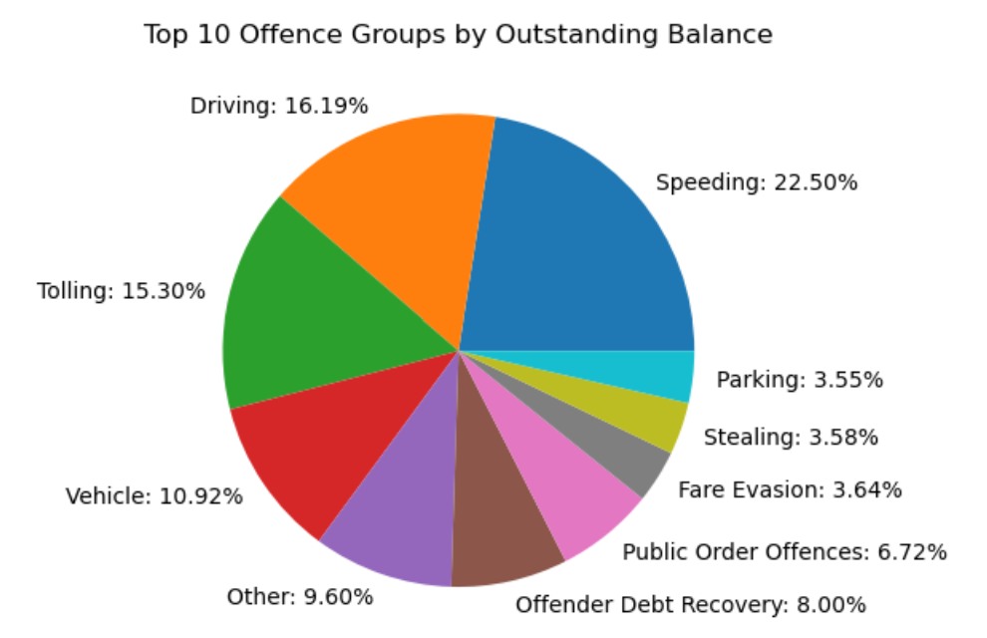
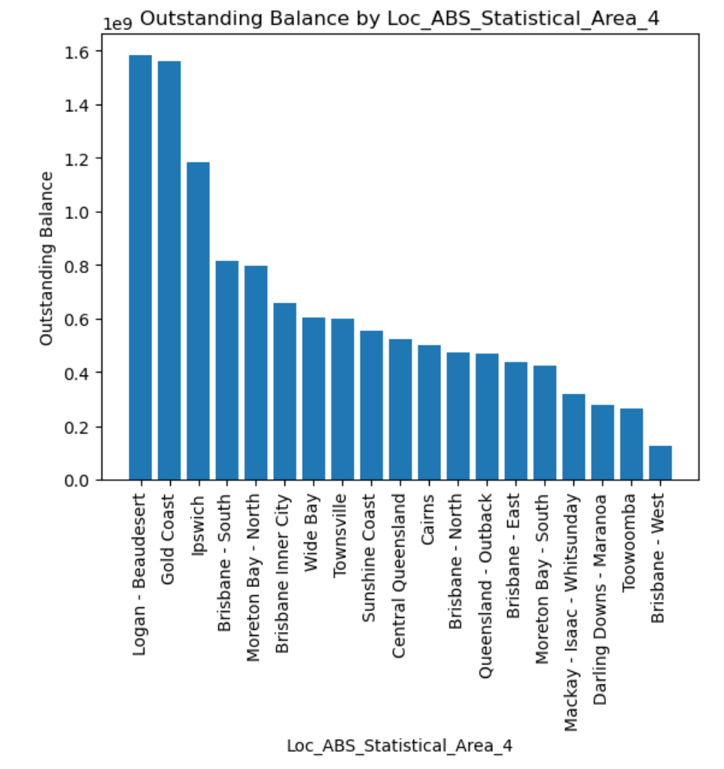
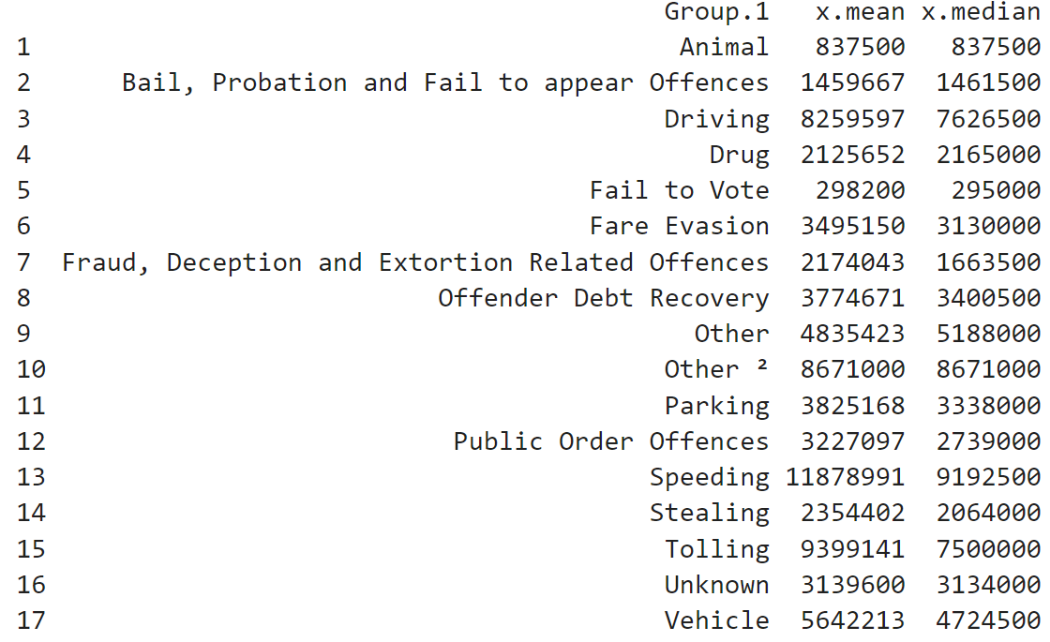
4. Making The Data Confess
The fourth step of the data science process involves making the data confess. During this step, we analyze and visualize the data to uncover hidden insights and patterns. By doing so, we aim to extract meaningful information that can help us answer our research or make predictions.
4.1 Exploratory Data Analysis
4.1.7 Top 10 Offence Contributed to Outstanding Balance
According to the chart, Speeding, Driving, and Tolling are the top three offenses that contribute the most to the outstanding balance, accounting for 22.5%, 16.19%, and 15.3% respectively. The trend showed that Logan having the highest outstanding balance of 1.6 billion, followed by Gold Coast with 1.5 billion, and Ipswich in third place with an outstanding balance of 1.2 billion. (See Appendix 2.6)
SUMMARY STATISTICS OF OUTSTANDING BALANCE

Slide 28
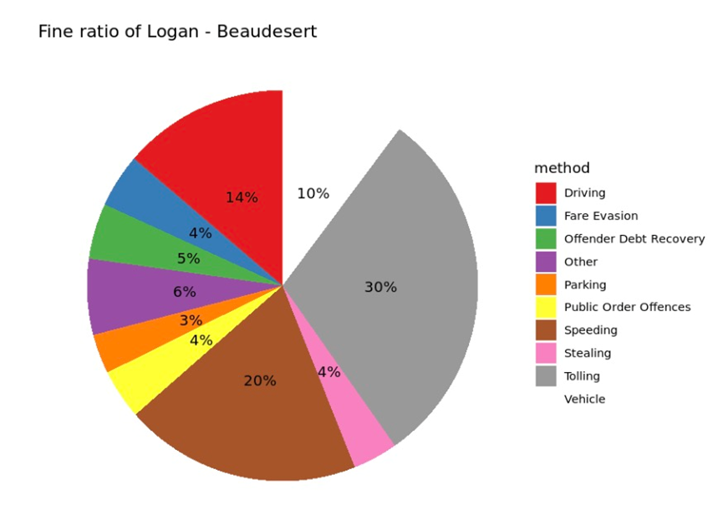
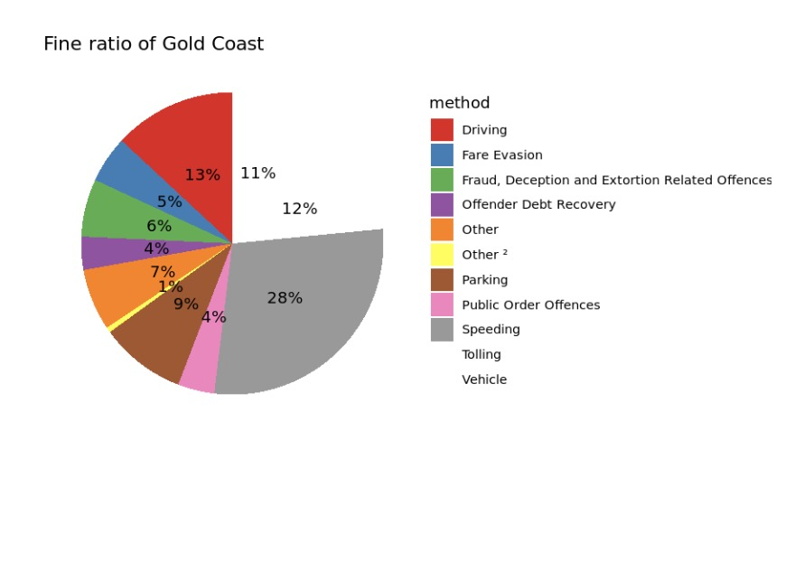
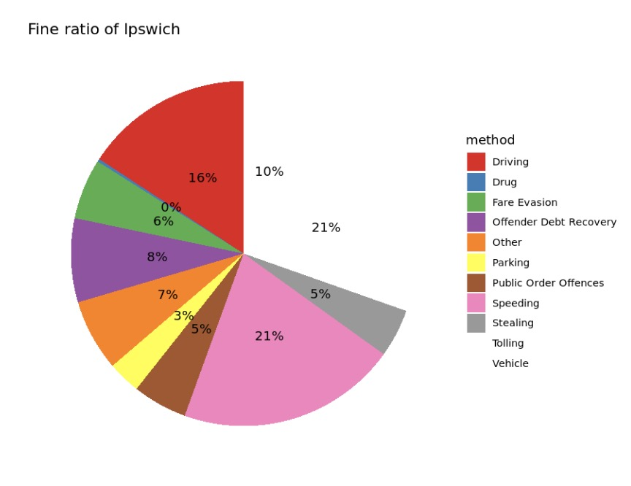
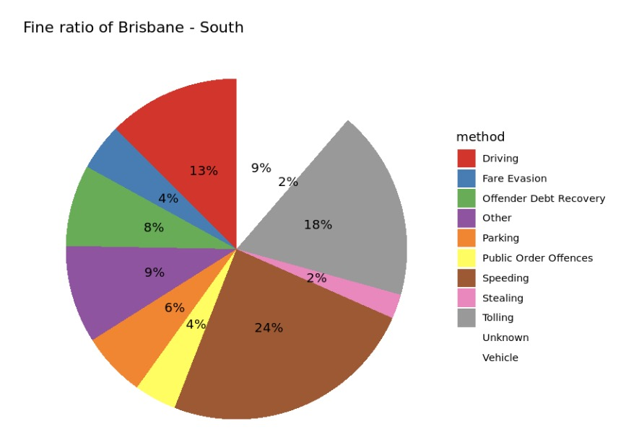
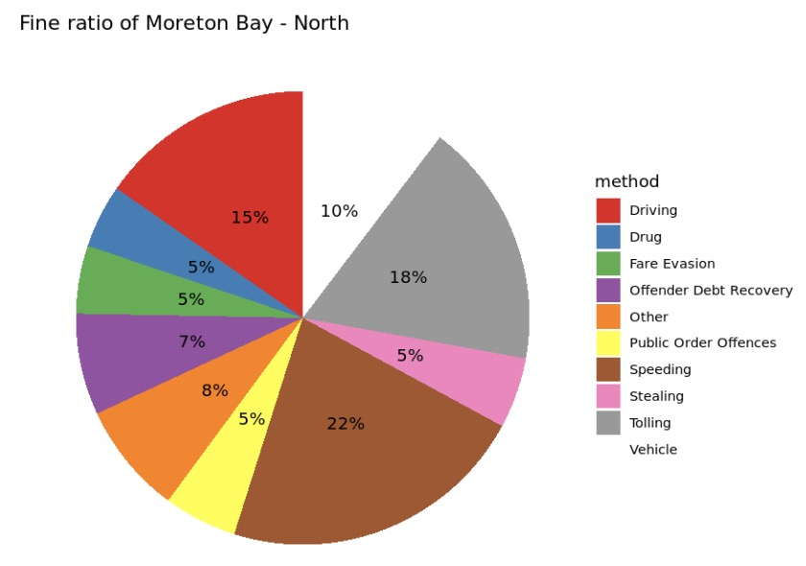
4. Making The Data Confess
The fourth step of the data science process involves making the data confess. During this step, we analyze and visualize the data to uncover hidden insights and patterns. By doing so, we aim to extract meaningful information that can help us answer our research or make predictions.
4.1 Exploratory Data Analysis
4.1.8 Proportion of Offence Contributed to Outstanding Balance
Based on the previous graph, it can be observed that the five areas with the highest number of outstanding balances are located in Logan, Gold Coast, Ipswich, Brisbane-South, and Moreton Bay North. In order to obtain a more detailed insight into the factors that contribute to the high number of Outstanding Balance, a pie chart can be created to determine the proportion of each offence group that has contributed to the number of Outstanding Balance. (Code in Appendix 2.7)
INSIGHT:
Almost all regions consistently show that speeding is the leading factor contributing to outstanding balances, with an average proportion of 25%. However, Logan differs from the others in that Tolling is the largest contributor. Furthermore, Tolling consistently ranks as the second largest contributor to the accumulation of outstanding balance, accounting for almost 20% in each region.

Slide 29


4. Making The Data Confess
The fourth step of the data science process involves making the data confess. During this step, we analyze and visualize the data to uncover hidden insights and patterns. By doing so, we aim to extract meaningful information that can help us answer our research or make predictions.
4.1 Exploratory Data Analysis
4.1.9 Cameras and Crash Locations
Plotting maps indicates that the number of installed speed cameras in Brisbane city is the largest number and also had the highest rate of happening crash accidents, followed by Gold coast. Comparing to other areas, although there are not many installed cameras, the number of crash accidents rarely happened such as Sunshine coast region and Moreton bay region. Therefore, there might be other factors relevant to these accidents since both maps indicate that the installation of speed cameras may not ensure a decrease in crash accidents.

Slide 30


4. Making The Data Confess
4.1 Exploratory Data Analysis
4.1.9 Cameras and Top 5 Crash Locations in Local Government Area
Brisbane: N: -27.460001, 153.014973 E: -27.463589, 153.035599 S: -27.480858, 153.029871 W: -27.467248, 153.010503
INSIGHT:
In Brisbane City, the number of cameras is insufficient in comparison to the number of crashes that occur. There are a significant number of accidents that happen in areas where cameras are not present.

Slide 31

4. Making The Data Confess
4.1 Exploratory Data Analysis
4.1.9 Cameras and Top 5 Crash Locations in Local Government Area
Gold coast: N: -27.690399, 153.255689 E: -28.164439, 153.551850 S: -28.265145, 153.232789 W: -28.192909, 153.184329
INSIGHT:
In Gold Coast, although some cameras are present in locations where crashes occur, there are still incidents of crashes that happen without any camera coverage.

Slide 32

4. Making The Data Confess
4.1 Exploratory Data Analysis
4.1.9 Cameras and Top 5 Crash Locations in Local Government Area
Logan city: N: -27.587315, 153.123311 E: -27.688190, 153.290340 S: -27.938566, 153.069691 W: -27.839125, 152.799330
INSIGHT:
In Logan City, also show that some cameras are present in locations where crashes occur, and there are still incidents of crashes that happen without any camera coverage.

Slide 33

4. Making The Data Confess
4.1 Exploratory Data Analysis
4.1.9 Cameras and Top 5 Crash Locations in Local Government Area
Moreton bay region: N: -26.792279, 152.761080 E: -27.081725, 153.207221 S: -27.422384, 152.861159 W: -26.955319, 152.651273
INSIGHT:
In the Moreton Bay Region, it is apparent that cameras are present in some locations where crashes occur, yet many incidents of crashes still transpire without any camera coverage. On the other hand, there are areas where cameras exist, but no accidents have been recorded.

Slide 34

4. Making The Data Confess
4.1 Exploratory Data Analysis
4.1.9 Cameras and Top 5 Crash Locations in Local Government Area
Sunshine coast region: N: -26.432195, 152.966377 E: -26.801726, 153.150790 S: -26.984769, 152.985184 W: -26.703135, 152.551100
INSIGHT:
In the Sunshine Coast Region, it is apparent that cameras are present in some locations where crashes occur, yet many incidents of crashes still transpire without any camera coverage. On the other hand, there are areas where cameras exist, but no accidents have been recorded.

Slide 35




4. Making The Data Confess
The fourth step of the data science process involves making the data confess. During this step, we analyze and visualize the data to uncover hidden insights and patterns. By doing so, we aim to extract meaningful information that can help us answer our research or make predictions.
4.2 Statistical Data Analysis
4.2.1 Regression Analysis to Outstanding Balance and Number of Debts
We calculate regression coefficients to identify which offense categories have the strongest relationship with outstanding balance. (Code in Appendix 2.8)
REGRESSION MODEL TO Y (OUTSTANDING BALANCE)
REGRESSION MODEL TO Y (NUMBER OF DEBTS)
INSIGHT:
The regression model output indicates that the model has a multiple R-squared of 0.3186, which suggests that the model explains approximately 31.86% of the variance in the outstanding balance variable. The adjusted R-squared of 0.3135 is slightly lower than the multiple R-squared, indicating that adding more predictors did not improve the explanatory power of the model. The F-statistic has a value of 62.63 and a p-value of less than 2.2e-16, which indicates that at least one of the predictors is significantly related to the outcome.
The coefficient values suggest that the method "Speeding" has a significantly positive relationship with the outstanding balance, as it has the highest coefficient value and a low p-value (0.000676). This implies that individuals with outstanding balances resulting from speeding offenses tend to have higher outstanding balances than those with other offenses.
Regarding the number of debts, the model has a multiple R-squared of 0.3802, indicating that the model explains approximately 38.02% of the variance in the number of debts variable. The adjusted R-squared of 0.3755 is slightly lower than the multiple R-squared, indicating that adding more predictors did not improve the explanatory power of the model. The F-statistic of 82.15 with 16 and 2143 degrees of freedom, and a p-value of less than 2.2e-16, indicates that at least one of the predictors is highly significant in explaining the variance in the outcome variable.
The coefficient values suggest that the method "Tolling" has a significantly positive relationship with the number of debts, as it has the highest coefficient value and a low p-value. This implies that individuals with outstanding balances resulting from tolling offenses tend to have more debts than those with other offenses

Slide 36

4. Making The Data Confess
The fourth step of the data science process involves making the data confess. During this step, we analyze and visualize the data to uncover hidden insights and patterns. By doing so, we aim to extract meaningful information that can help us answer our research or make predictions.
4.2 Statistical Data Analysis
4.2.1 Poisson Regression for Analyzing Involvement Factors to Count of Crashes
In our factor of crash dataset, both the "Crash Count" and "Count all casualties" variables involve counting and accumulation of data, making them more suitable for modeling with count data analysis methods such as Poisson regression. We create 5 models:

Slide 37


4. Making The Data Confess
4.2 Statistical Data Analysis
4.2.1 Poisson Regression for Analyzing Involvement Factors to Count of Crashes
Based on the fifth models, the last models give the lowest AIC. (Code in Appendix 2.9)
INSIGHT:
The results of the poisson regression analysis suggest that Involving Drinking Driving, Involving Driver Speed, Involving Fatigued Driver, and Involving Defective Vehicle are all significant predictors of the count of crashes. These variables can explain some, but not all, of the variability in the count of crashes. Additionally, there appears to be a linear relationship between the combination of these four variables and the occurrence of car accidents. As the occurrences of these situations increase, the probability of a car accident also increases. The red line in the graph illustrates this linear relationship between these situations and the number of car accidents. Overall, these findings provide important insights into the factors that contribute to car accidents, and can inform strategies for reducing the occurrence of car accidents on the road

Slide 38

4. Making The Data Confess
The fourth step of the data science process involves making the data confess. During this step, we analyze and visualize the data to uncover hidden insights and patterns. By doing so, we aim to extract meaningful information that can help us answer our research or make predictions.
4.2 Statistical Data Analysis
4.2.2 Poisson Regression for Analyzing Involvement Factors to Count of Casualties
Poisson regression is primarily used for modeling count data. In our factor of crash dataset, both the "Crash Count" and "Count all casualties" variables involve counting and accumulation of data, making them more suitable for modeling with count data analysis methods such as Poisson regression. We create 5 models:

Slide 39


4. Making The Data Confess
4.2 Statistical Data Analysis
4.2.2 Poisson Regression for Analyzing Involvement Factors to Count of Casualties
Based on the fifth models, the last models give the lowest AIC.
INSIGHT:
The results of the model indicate that involving driving while under the influence of alcohol, speeding, driving while fatigued, and driving a defective vehicle are all significant predictors of the count of all casualties in car accidents. However, the model does not explain all of the variability in the count of casualties. Additionally, the model suggests that there is a linear relationship between the combination of these four variables and the occurrence of casualties. As the occurrences of these situations increase, the probability of casualties also increases, and this relationship is demonstrated by the red line in the graph. Overall, these findings can help to inform efforts to reduce the occurrence of car accidents and associated casualties.

Slide 40
STEP 5.
DATA STORY TELLING

Slide 41
5. Data Story Telling
The last step of the data science process involves is tell the whole story of our findings in the fourth step. We hope our story can reveal hidden trends, uncover new insights, and help stakeholders better understand the data and its implications.
5.1 Exploration Data Analysis Findings
Throughout the year 2021, the number of crashes varied significantly across all areas. Brisbane City, Gold Coast City, Logan City, Moreton Bay Region, and Sunshine Coast Region had the highest number of crashes. The majority of crash severity incidents resulted in hospitalization and medical treatment, with the absence of traffic control, operating traffic lights, and Give Way Signs being the top three causes of crashes. Interestingly, the highest number of crashes occurred at 60 km/h, rather than at speeds of 100-110 km/h. Additionally, hospitalization was the most prevalent crash severity resulting from the involvement of drinking while driving, driver's speed, fatigued driving, and defective vehicles.
There is a weak to moderate association between the predictor variables and Crash_Severity, with Involving_Defective_Vehicle and Involving_Drink_Driving being the two most important predictor variables associated with Crash_Severity across all areas of crash. Nearly half of the total number of debts were caused by offender debt recovery, followed by Fraud Offence and Tolling, with Toowoomba, Darling Downs, and Brisbane East having the highest number of debts. Across all five regions, speeding consistently contributes to around 20% of the number of debtors.
The installation of speed cameras may not lead to a decrease in the number of crash accidents in certain regions, as evidenced by the presence of accidents in areas with cameras and the absence of accidents in areas with cameras, indicating the possibility of other relevant factors.
Speeding, driving, and tolling are the top three offenses that contribute the most to the outstanding balance, with Logan having the highest outstanding balance, followed by Gold Coast and Ipswich. Speeding is the leading factor contributing to outstanding balances in almost all regions, with Tolling being the largest contributor in Logan.

Slide 42
5. Data Story Telling
The last step of the data science process involves is tell the whole story of our findings in the fourth step. We hope our story can reveal hidden trends, uncover new insights, and help stakeholders better understand the data and its implications.
5.2 Statistical Data Analysis Findings
After conducting an in-depth analysis of the data, several key insights were revealed. Firstly, the number of car crashes fluctuated significantly throughout the year 2021, with Brisbane City, Gold Coast City, Logan City, Moreton Bay Region, and Sunshine Coast Region being the top five areas with the highest number of crashes. Factors such as driver speed and road conditions were found to contribute to the occurrence of car accidents, with hospitalization being the most prevalent crash severity.
When it comes to outstanding balances and the number of debts, speeding and tolling offenses were found to have a significantly positive relationship with outstanding balance and the number of debts, respectively. This suggests that individuals with outstanding balances resulting from speeding and tolling offenses tend to have higher outstanding balances and more debts than those with other offenses.
Lastly, the involvement of drinking while driving, driver speed, fatigued driving, and defective vehicles were all found to be significant predictors of the count of car crashes and associated casualties. As the occurrences of these situations increase, the probability of car accidents and casualties also increases. These findings can help inform strategies to reduce the occurrence of car accidents and associated casualties on the road.
Overall, these insights highlight the importance of addressing key factors such as driver behavior and road conditions to reduce the number of car accidents and associated costs in the community.

Slide 43
5. Data Story Telling
The last step of the data science process involves is tell the whole story of our findings in the fourth step. We hope our story can reveal hidden trends, uncover new insights, and help stakeholders better understand the data and its implications.
5.3 Conclusions and Suggestions
5.3.1 Conclusions
In conclusion, the analysis of the data revealed that Brisbane City, Gold Coast City, Logan City, Moreton Bay Region, and Sunshine Coast Region had the highest number of car crashes throughout the year 2021. Factors such as driver speed, road conditions, and the involvement of drinking while driving, driver speed, fatigued driving, and defective vehicles were found to be significant predictors of car crashes and associated casualties. Additionally, speeding and tolling offenses were found to have a significant positive relationship with outstanding balances and the number of debts.
Furthermore, the installation of speed cameras may not necessarily lead to a decrease in the number of crash accidents in certain regions. While Brisbane and Gold Coast have a relatively high number of cameras installed, there are still incidents of crashes that occur without any camera coverage. On the other hand, regions such as Moreton Bay and Sunshine Coast have a lower number of installed cameras, yet there are areas where accidents still occur despite the presence of cameras. Thus, it is possible that other factors may be relevant to these accidents. Overall, this suggests that simply installing speed cameras may not be a comprehensive solution to reducing the number of accidents and other factors need to be considered.

Slide 44
5. Data Story Telling
The last step of the data science process involves is tell the whole story of our findings in the fourth step. We hope our story can reveal hidden trends, uncover new insights, and help stakeholders better understand the data and its implications.
5.3 Conclusions and Suggestions
5.3.2 Suggestions to Stakeholders:
Government: The government should invest in improving road conditions and implement stricter laws and regulations to ensure that drivers adhere to traffic rules. They should also encourage the adoption of new technologies such as automated vehicles to reduce the probability of accidents caused by human errors. Additionally, it may be beneficial to conduct further research to better understand the effectiveness of speed cameras and other measures in reducing accidents, as well as to identify any other factors that may be relevant
Traffic Police: The traffic police should increase the number of random breath tests and roadside checks to curb the occurrence of drink-driving. They should also enforce speed limits and ensure that drivers adhere to traffic rules to reduce the probability of car crashes.
Drivers: Drivers should be encouraged to practice safe driving by adhering to traffic rules, avoiding driving while under the influence of alcohol or drugs, and ensuring that their vehicles are in good condition. They should also consider taking regular breaks during long drives to prevent fatigue and reduce the probability of accidents.
Insurance Companies: Insurance companies should consider offering discounts to drivers who adhere to traffic rules, have a good driving record, and have their vehicles regularly serviced to incentivize safe driving behavior.
General Public: The general public should be encouraged to report any incidents of reckless driving, defective vehicles, and road hazards to the appropriate authorities. They should also be educated on the importance of safe driving practices to reduce the probability of car crashes and associated costs.

Slide 45
THANK YOU ☺

